Slide 1
Women in Medicine & Science University of Cincinnati
September 30, 2015

Slide 2
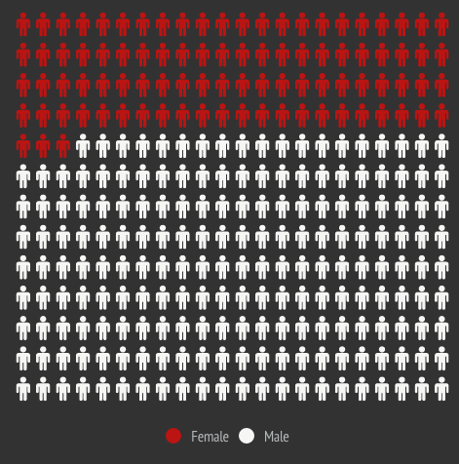
2013/2014 SURVEY RESULTS

Slide 3
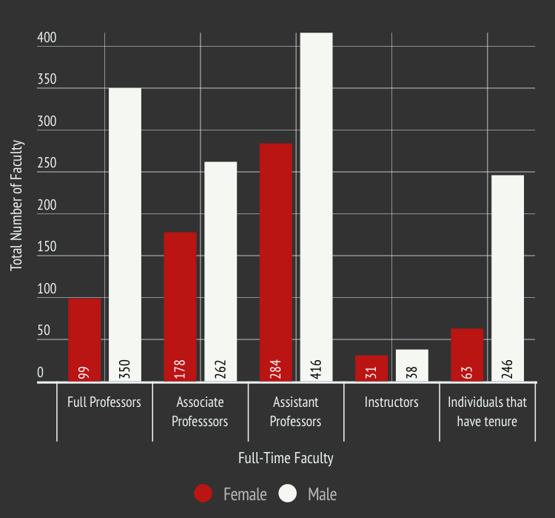
N (%) | Full Professors | Associate Professors | Assistant Professors | Instructors | Individuals that have tenure
Female | 99 (22) | 178 (40) | 284 (41) | 31 (45) | 63 (20)
Male | 350 (78) | 262 (60) | 416 (59) | 38 (55) | 246 (80)

Slide 4
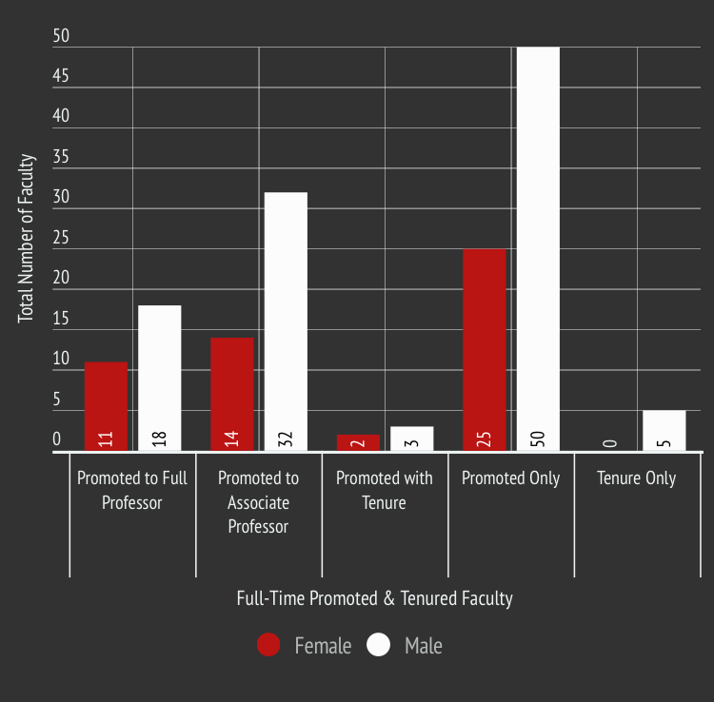
N (%) | Promoted to Full Professor | Promoted to Associate Professor | Promoted with Tenure | Promoted Only | Tenure Only
Female | 11 (38) | 14 (30) | 2 (40) | 25 (33) | 0 (0)
Male | 18 (62) | 32 (70) | 3 (60) | 50 (67) | 5 (100)

Slide 5
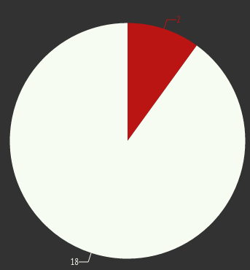
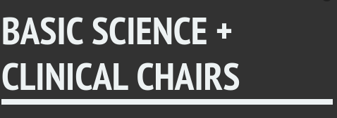
N (%) | Associate/Vice Chairs | Basic Science Chairs | Clinical Chairs | Division Chiefs
Female | 8 (23) | 0 (0) | 2 (12) | 95 (79)
Male | 27 (77) | 3 (100) | 15 (88) | 25 (21)

Slide 6
New Hires
N (%) | Full Professors | Associate Professors | Assistant Professors | Instructors
Female | 1 (8) | 6 (55) | 46 (41) | 13 (42)
Male | 11 (92) | 5 (45) | 67 (59) | 18 (58)
Departures
N (%) | Full Professors | Associate Professors | Assistant Professors | Instructors
Female | 6 (15) | 7 (30) | 20 (47) | 5 (50)
Male | 34 (85) | 16 (70) | 23 (53) | 5 (50)

Slide 7
Full-Time Faculty Department Breakdown – Female & Male (excludes affiliate faculty)
Department/Total Number of Faculty | Female N(%) | Male N(%)
Anesthesiology (n=59) | 20 (34) | 39 (66)
Biomedical Informatics (n=1) | 0 (0) | 1 (100)
Cancer Biology (n=14) | 6 (43) | 8 (57)
Dermatology (n=9) | 2 (22) | 7 (78)
Emergency Medicine (n=56) | 14 (25) | 42 (75)
Environmental Health (n=37) | 9 (24) | 28 (76)
Family & Community Medicine (n=28) | 12 (43) | 16 (57)
Internal Medicine (n=208) | 73 (35) | 135 (65)
Medical Education (n=5) | 1 (20) | 4 (80)
Molecular & Cellular Physiology (n=11) | 3 (27) | 8 (73)
Molecular Genetics, Biochemistry & Microbiology (n=17) | 1 (6) | 16 (94)
Neurology & Rehabilitation Medicine (n=44) | 15 (34) | 29 (66)
Department/Total Number of Faculty | Female N(%) | Male N(%)
Neurosurgery (n=13) | 0 (0) | 13 (100)
Obstetrics & Gynecology (n=37) | 22 (59) | 15 (41)
Ophthalmology (n=14) | 4 (29) | 10 (71)
Orthopedic Surgery (n=18) | 2 (11) | 16 (89)
Otolaryngology/Head & Neck Surgery (n=22) | 2 (9) | 20 (91)
Pathology & Laboratory Medicine (n=27) | 8 (30) | 19 (70)
Pediatrics (n=4) | 1 (25) | 3 (75)
Pharmacology & Cell Biophysics (n=9) | 2 (22) | 7 (78)
Psychiatry & Behavioral Neuroscience (n=87) | 40 (46) | 47 (54)
Radiation Oncology (n=9) | 2 (22) | 7 (78)
Radiology (n=38) | 13 (34) | 25 (66)
Surgery (n=75) | 16 (21) | 59 (79)

Slide 8
WIMS The University of Kansas
Mission: http://www.kumc.edu/wims/mission.html
Leadership Transition Training, provides new leader positions with training, successful skills & tools, job descriptions, and an experienced mentor to ensure that the leader/organization succeeds
Leadership/Infrastructure: http://www.kumc.edu/wims/leadership-and-infrastructure.html
Get Involved Committees: http://www.kumc.edu/wims/get-involved---committees.html
Bylaws: http://www.kumc.edu/Documents/wims/WIMS_Bylaws.pdf

Slide 9
WIMS University of Cincinnati Chapter
Next Steps…
Draft Mission
Draft Goals
Identify Interim Executive Council members
President, Secretary, Treasurer, Representatives
Chairs of Committees: Mentoring, Recognition, and Program
Representatives from medical students, post-doc, grad students
COM support and tap into existing programming
Create mechanism to recognize accomplishments of women faculty
Funding support for the AAMC Early and Mid-career Women Professional development Seminars:
Registration for two female Assistant Professors and two female Associate Professors (Department to cover travel and lodging)
Increase visibility
Join network of WIMS from other institutions
Website and Branding

Slide 10
Join GWIMS “The AAMC serves and leads the academic medicine community to improve the health of all.”
Beyond the GWIMS Designated Representatives, additional faculty members or administrators with a sustained interest in the GWIMS agenda and who want to be involved in a concrete way are also welcome to join GWIMS. This is an open membership, so either the deans and CEOs of member organizations can put forth the names of additional members or individuals can self-nominate by emailing gwims@aamc.org.
Member Benefits
Participate in the advancement of women in academic medicine in a national forum
Expand your professional network
Access new potential opportunities for mentorship
Learn new best practices from other organizations that advance women’s successful participation in academic medicine

Slide 11
Faculty Rank & Tenure
Part-Time Faculty
N (%) | Full Professors | Associate Professors | Assistant Professors | Instructors | Individuals that have tenure
Female | 8 (16) | 24 (52) | 69 (61) | 18 (38) | 0 (0)
Male | 42 (84) | 22 (48) | 44 (39) | 9 (33) | 2 (100)
Volunteer Faculty
N (%) | Full Professors | Associate Professors | Assistant Professors | Instructors | Individuals that have tenure
Female | 8 (15) | 15 (16) | 60 (31) | 21 (42) | 0 (0)
Male | 47 (85) | 79 (84) | 132 (69) | 29 (58) | 0 (0)

