Slide 1

Welcome to the
University of Cincinnati’s
Women in
Medicine & Science
Chapter
Est. 2015
NOVEMBER 29, 2017
7:15-8:15 AM
MSB-3051

Slide 2
AGENDA
Welcome & Introductions - Amy Bunger, PhD
Wellness Survey - Alison Weiss, PhD
Teresa Woodruff Visit
Next WIMS Meeting
Update on LEAF Climate Survey & Focus Groups - Valerie Hardcastle, PhD
Next Steps - Amy Bunger, PhD

Slide 3
Physician Well-Being Index
  Validated screening tool to evaluate fatigue, depression, burnout, and anxiety/stress in physicians
  9 questions – quick and easy
  Provides direct, confidential feedback to physicians about their wellness and links to national and local resources to assist them
  Provides general information to leadership about overall wellness amongst clinical faculty
  Rollout: October 2, 2017
  Participants to date: 135 (~10% UC; ~6% UC + Affiliates)

Slide 4
During the past month, have you felt burned out from your work? Yes/No
During the past month, have you worried that your work is hardening you emotionally? Yes/No
During the past month, have you often been bothered by feeling down, depressed, or hopeless? Yes/No
During the past month, have you fallen asleep while sitting inactive in a public place? Yes/No
During the past month, have you felt that all things you had to do were piling up so high that you could not overcome them? Yes/No
During the past month, have you been bothered by emotional problems (such as feeling anxious, depressed, or irritable)? Yes/No
During the past month, has your physical health interfered with your ability to do your daily work at home and/or away from home? Yes/No
The work I do is meaningful to me.
Very Strongly Disagree / Very Strongly Agree (scale of 1-9)
My work schedule leaves me enough time for my personal/family life. Strongly Disagree / Strongly Agree (scale of 1-5)

Slide 5
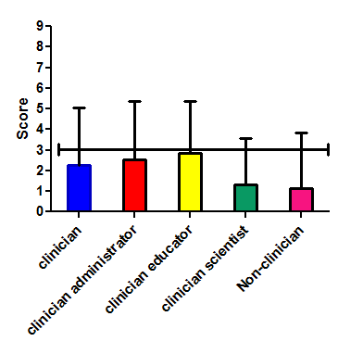
Physician Well-Being Index
Based on a sample of US physicians (n=6880), those with a
Well-Being Index score ≥3 were shown to be at greater risk for number of adverse outcomes including:
        2-fold higher risk of medical error
        5-fold higher risk of burnout
        4-fold higher risk of severe fatigue
        2-fold higher risk of suicidal ideation
        3-fold higher risk poor overall quality of life

Slide 6
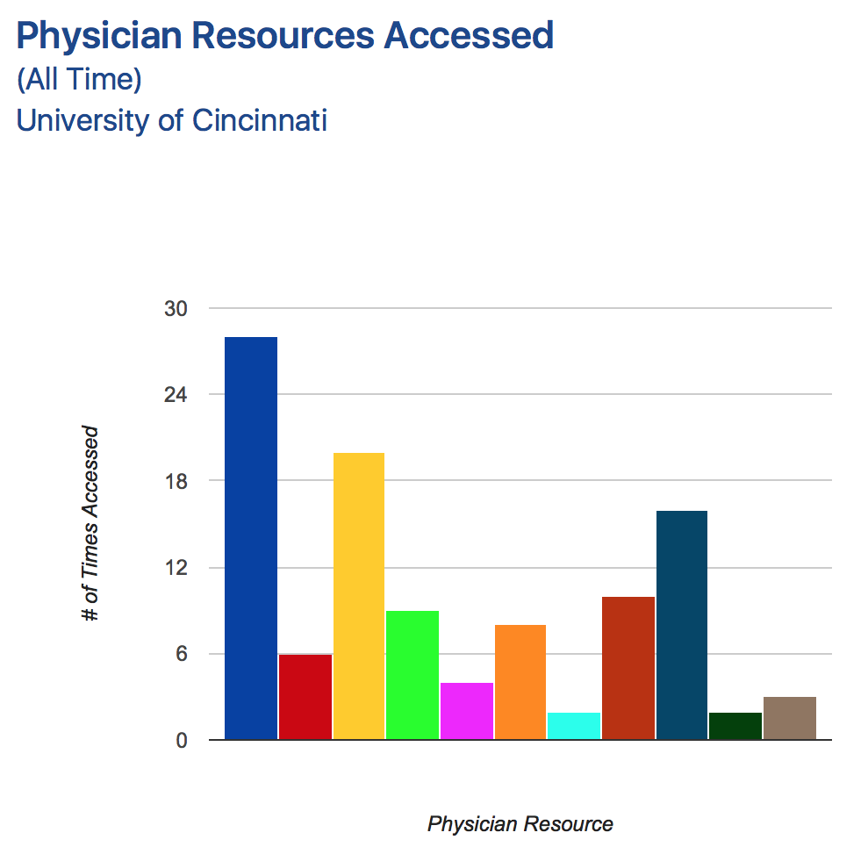
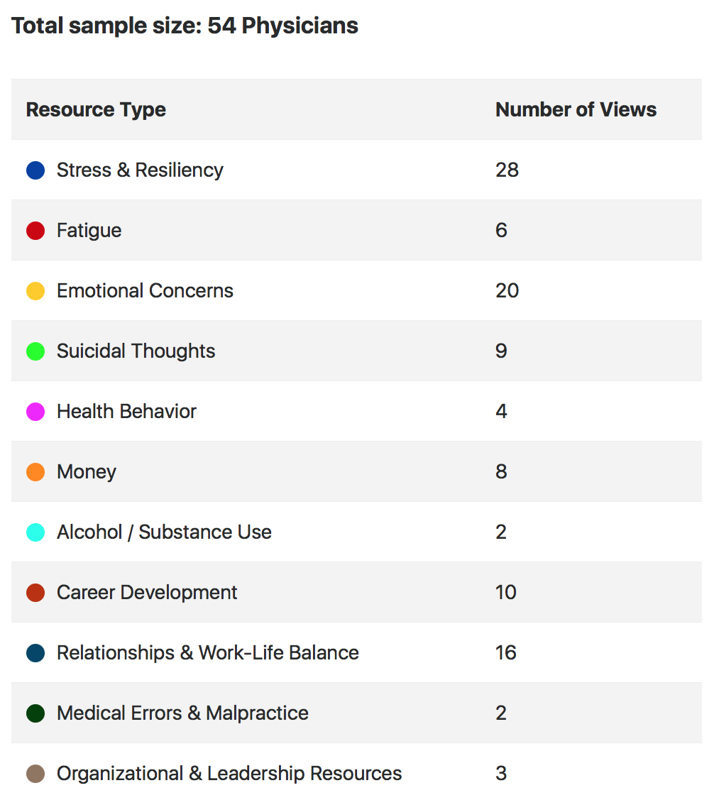

Slide 7


Slide 8
NEXT WIMS MEETING
Wednesday, January 31
12-1 PM, MSB-2001
MONTH | TIME | LOCATION | TOPIC | SPEAKER
January 31, 2018 | 12-1 PM | MSB-2001 | WIMS in the COM | William Ball, MD
February 1, 2018 | 12-1 PM | TBD | WIMS Special Speaker | Teresa Woodruff, PhD
February 28, 2018 | 12-1 PM | MSB-2001 | Negotiate Like a Girl | Jane Sojka, PhD
March 28, 2018 | 7:15-8:15 AM | MSB-2001 | Head Games | Jane Sojka, PhD
April 25, 2018 | 12-1 PM | MSB-2001 | Communicate with Power | Jane Sojka, PhD
May 30, 2018 | 12-1 PM | MSB-2001 | Giving an Interview | UC PR, to be named

Slide 9
COM FEMALE Faculty
Focus Group Discussions
Valerie Hardcastle, PhD
Professor, McMicken College of Arts & Sciences

Slide 10
2016 LEAF Survey Results
Women more likely than men to affirm that:
  RPT guidelines do not align with professional aims
  Annual reviews do not help career advancement
  They have had negative work experiences
  (harassment, micro-aggressions, different standards)
  They are not treated respectfully when disagreeing with colleagues
  Their unit’s do not adequately recruit and support women and diverse faculty
  They are satisfied with staff support

Slide 11
2017 Focus Groups
Five Themes Emerged
  A Gendered Work Environment
  A Culture of Silence/Absence of Psychological Safety
  Inconsistent Unit-Level Leadership and Accountability
  Lack of Transparency and Participation in Governance
  Reward System Out-of-Whack

Slide 12
Gendered Work Environment
Vivid examples of interactions with male faculty that could constitute gender discrimination or hostile environment for female faculty
Frustration with ability to confront such behavior or hold instigators responsible
Women faculty perform a larger share of “institutional housekeeping” service work
Perceptions that research and billable time are less protected for women than for men

Slide 13
Culture of Silence
(Absence of Psychological Safety)
Do not feel safe speaking up against decisions being made (e.g., hiring, leadership, environmental concerns, and policy and practice change)
Explicitly told to stay silent
Penalized for speaking up

Slide 14
Inconsistent Unit-Level Leadership and Accountability
Not a gendered issue
Many leaders
  Do not have the support of faculty—even oppose faculty
  Lack a successful track record
  Do not demonstrate support for faculty development
There is no system of accountability
  Chairs/heads have little power
  Not held accountable for supporting faculty needs
  No procedure in place to monitor chair/head performance

Slide 15
Lack of Transparency and Participation in Governance
Faculty Perceive
  Power is held by finance/business area, not heads/chairs
  Decisions are based solely on financial considerations
  There is a top-down hierarchy with little opportunity to provide input on decisions that directly affect work
Administration who focus on diversity and faculty development are in limited roles and unable to fully engage in these matters

Slide 16
Reward System Out-of-Whack
Reward system is inconsistent with RPT criteria and faculty preferences
College funding model places pressure on RVUs
  Less time for patient care
  Less time for research and teaching
Perceives the administration requires faculty to increase college funding at the expense of research, teaching and service missions

Slide 17
Recommendations from Faculty
Require faculty-driven annual reviews for decanal-level and unit head administrators
Adopt a chair/vice chair model (esteemed chair provides vision, vice chair has administrative and interpersonal skills to work with faculty)
Require training to enhance leadership skills of chairs/heads
Seek funding to invest in efforts that support climate change
Better leverage, engage, and reward senior male faculty who advocate for women and URM faculty
Provide follow-up Title IX training for women faculty and students; work with college leaders to limit inadvertently rewarding perpetrators

Slide 18

Faculty Retention
2005 - 2017

Slide 19
Assistant Professors
Gender Differences in Faculty Trajectories

Slide 20
Assistant Professors
2005 - 2017
COM Assistant Professors
UC Assistant Professors
13
387
48
406

Slide 21
Assistant Professor Outcomes
Gender Differences After 7 Years in Rank
COM Women
4
5
4
5
COM Men
18
17
11
2
UC Women
155
132
91
9
6
UC Men
189
137
73
7
Median
years to promotion

Slide 22
Assistant Professors
Race/Ethnicity Differences in Faculty Trajectories

Slide 23
Assistant Professors
2005 - 2017
COM Assistant Professors
UC Assistant Professors
150
25
88
33
522
2

Slide 24
Assistant Professor Outcomes
Race/Ethnicity Differences After 7 Years in Rank
COM Asian
11
8
4
2
4.5
COM URM
2
COM White
5
11
14
8
UC Asian
82
21
2
5.5
45
UC URM
47
23
17
1
6
UC White
204
190
115
13
6
Median
years to promotion

Slide 25
Associate Professors
Gender Differences in Faculty Trajectories

Slide 26
Associate Professors
2005 - 2017
COM Associate Professors
UC Associate Professors
24
292
50
316

Slide 27
Associate Professor Outcomes
Gender Differences After 10 Years in Rank
COM Women
7.5
12
2
9
1
COM Men
6
22
18
9
1
UC Women
6
192
59
39
2
UC Men
191
83
40
2
6
Median
years to promotion

Slide 28
Associate Professors
Race/Ethnicity Differences in Faculty Trajectories

Slide 29
Associate Professors
2005 - 2017
COM Associate Professors
UC Associate Professors
23
100
44
424
53
4

Slide 30
Associate Professor Outcomes
Race/Ethnicity Differences After 10 Years in Rank
COM Asian
4.5
12
7
2
2
COM URM
2
2
6.5
COM White
19
11
14
6.5
UC Asian
63
11
5
24
2
UC URM
32
11
10
7
UC White
261
105
56
2
6
Median
years to promotion

