Slide 1
Welcome to the University of Cincinnati’s Women in Medicine & Science Chapter
Est. 2015
March 30, 2017
MSB-2001

Slide 2
AGENDA ITEMS
Welcome & Call to Order – President, Erin Haynes, DrPH
Negotiation Presentation
Maria Espinola, Psy.D.
Assistant Professor of Clinical Psychiatry
Department of Psychiatry and Behavioral Neuroscience
3. Fundraising Committee Update – Chair, Florence Rothenberg, MD
Next Meeting: Wednesday, April 26, 2017, noon-1:30 PM, MSB-2001

Slide 3
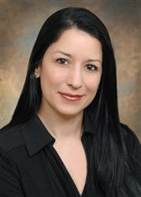
WIMS Presentation: NEGOTIATION
Maria Espinola, Psy.D.
Assistant Professor of Clinical Psychiatry
Department of Psychiatry and Behavioral Neuroscience
University of Cincinnati, College of Medicine

Slide 4
UPCOMING EVENTS
Next Meeting: Wednesday, April 26, 2017, noon-1:30 PM, MSB-2001

