Slide 1

Welcome to the
University of Cincinnati’s
Women in
Medicine & Science
Chapter
Est. 2015
SEPTEMBER 27, 2017
12-1 PM
MSB-3051

Slide 2

AGENDA
Welcome & Introductions
WIMS Leadership
WIMS Fund
Next WIMS Meeting
Pink Tax Bill: Maria Espinola, Psy.D.
ANNUAL FACULTY DATA REPORT
Kelly Brunst, PhD & Liza Murrison, PhD
UPDATE ON LEAF CLIMATE & SURVEY GROUPS
Valerie Hardcastle, PhD

Slide 3
WIMS LEADERSHIP
President: Erin N. Haynes, DrPH
President-elect: Amy Bunger, PhD
Secretary: Jennifer Forrester, MD
Secretary-elect: Heather Christensen, PhD
Treasurer: Mercedes Falciglia, MD
Treasurer-elect: Vinita Takiar, MD
Basic Science Representative: Alison Weiss, PhD
Clinical Science Representatives:
Jennifer Cavitt, MD & Pamposh Kaul, MD

Slide 4

The WIMS Fund is now open!

Slide 5
THANK YOU TO THE
First Fabulous Five Friends of WIMS
Amy Bunger, PhD
Patricia Carey, MD
Erin Haynes, DrPH
Sarah Pixley, PhD
Florence Rothenberg, MD

Slide 6
NEXT WIMS MEETING
Wednesday, October 25
12-1 PM, MSB-3051
MONTH | TIME | LOCATION | TOPIC | SPEAKER
October 25, 2017 | 12-1 PM | MSB-3051 | Health Policy Update | Dawn Kleindorfer, MD
November 29, 2017 | 7:15-8:15 AM | MSB-2001 | Updates from LEAF | Valerie Hardcastle, PhD
January 31, 2018 | 12-1 PM | MSB-2001 | WIMS in the COM | William Ball, MD
February 28, 2018 | 12-1 PM | MSB-2001 | Negotiate Like a Girl | Jane Sojka, PhD
March 28, 2018 | 7:15-8:15 AM | MSB-2001 | Head Games | Jane Sojka, PhD
April 25, 2018 | 12-1 PM | MSB-2001 | Communicate with Power | Jane Sojka, PhD
May 30, 2018 | 12-1 PM | MSB-2001 | Giving an Interview | UC PR, to be named

Slide 7
PINK TAX BILL
Maria Espinola, Psy.D.
Assistant Professor in Clinical Psychiatry
Department of Psychiatry & Behavioral Neuroscience
Primary sponsor: Brigid Kelly (D), House Representative District 31
The bill exempts from sales and use tax of feminine hygiene products principally used in connection with the menstrual cycle, e.g. tampons, panty liners, menstrual cups, and sanitary napkins.
The bill seeks to address the inequity of taxing products related to health.
This year, the same committee voted to exempt prescription eyeglasses, contact lenses, and other optical aids from sales and use tax, because Ohioans should not be forced to pay a tax on items they need to live healthy and productive lives. The same rationalization extends to feminine hygiene products.

Slide 8
ANNUAL FACULTY
DATA REPORT
Kelly Brunst, PhD & Liza Murrison, PhD
Department of Environmental Health

Slide 9
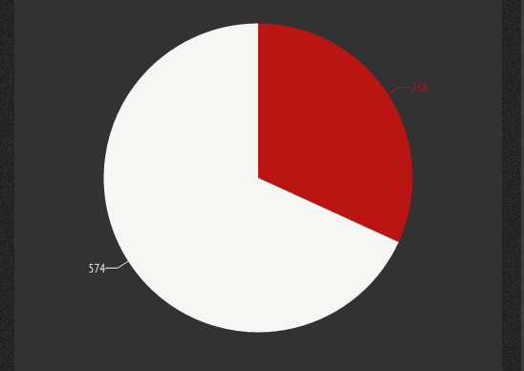

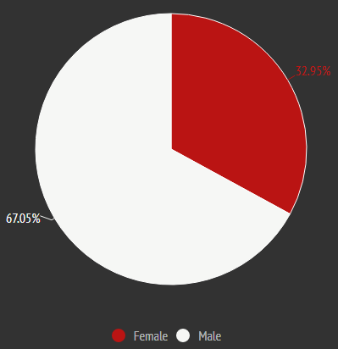
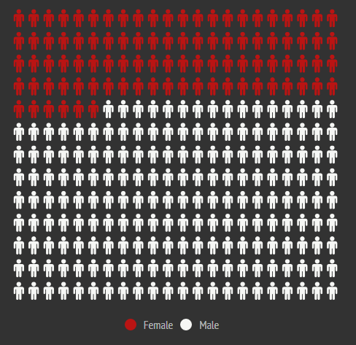
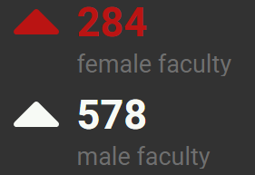
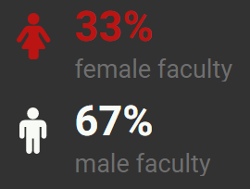
2017 FACULTY DATA
(FULL-TIME FACULTY - EXCLUDES AFFILIATE)
AAMC Benchmark: 38% of full-time faculty are women
Notes:
2016
Women: 271 (32)
Men: 585 (68)
2014
Women: 268 (32)
Men: 574 (68)

Slide 10
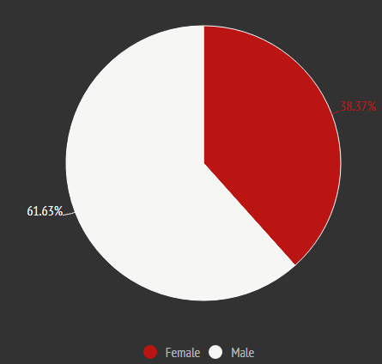
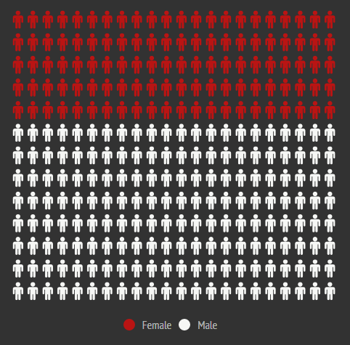
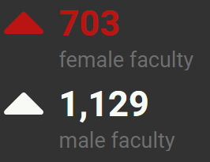
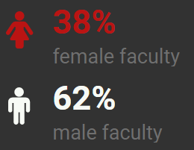
(FULL-TIME FACULTY - INCLUDING AFFILIATE: VA, CCHMC, CEI)
AAMC Benchmark: 38% of full-time faculty are women

Slide 11
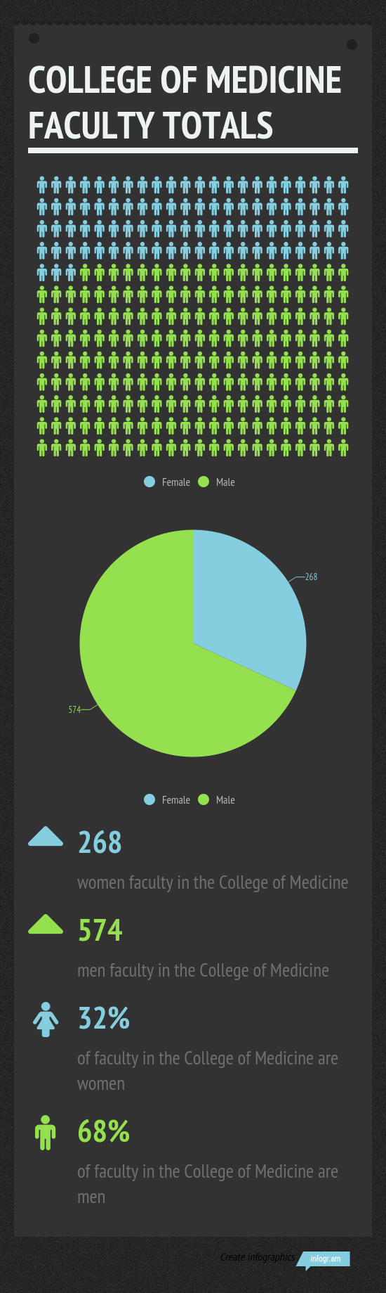

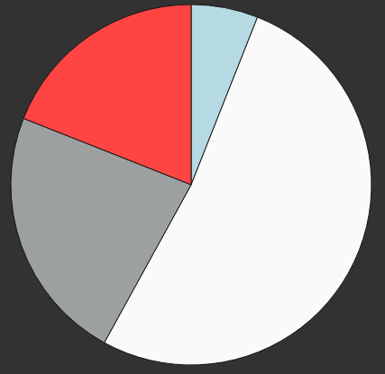
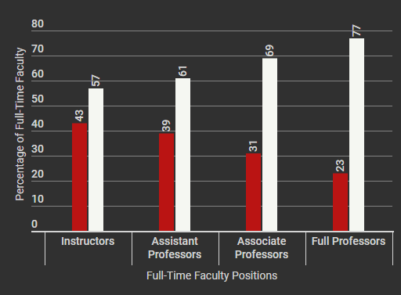
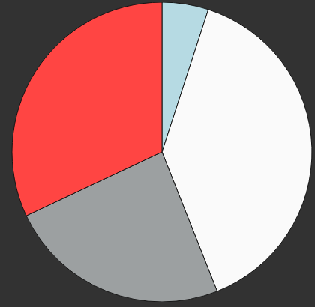

FEMALE
(EXCLUDES AFFILIATE)
Instructor: 6%
Full: 19%
Associate: 23%
Assistant: 52%
MALE
Instructor: 5%
Full: 32%
Assistant: 39%
AAMC Benchmark: 21% of full professors are women
Associate: 24%
Notes:
FEMALE DATA ONLY
2016
Instructor: 19 (42)
Assistant Professor: 138 (37)
Associate Professor: 63 (32)
Full Professor: 51 (21)
2014
Instructor: 31 (45)
Assistant Professor: 284 (41)
Associate Professor: 178 (40)
Full Professor: 99 (22)

Slide 12
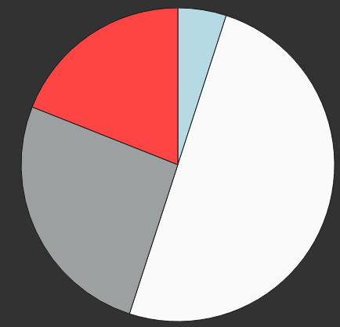
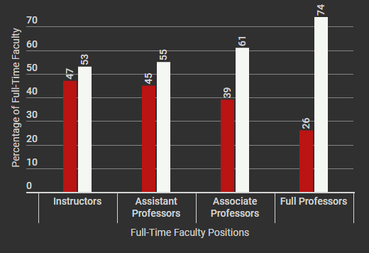
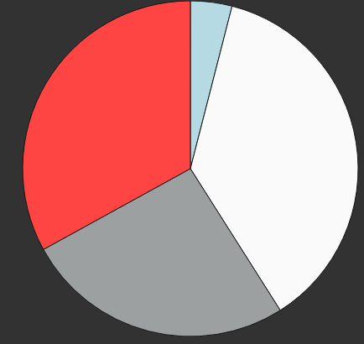
FEMALE
(INCLUDING AFFILIATE: VA, CCHMC, CEI)
Instructor: 5%
Full: 19%
Assistant: 50%
Associate: 26%
MALE
Instructor: 4%
Full: 33%
Assistant: 37%
AAMC Benchmark: 21% of full professors are women
Associate: 26%

Slide 13

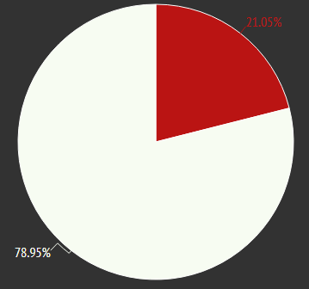



(EXCLUDES AFFILIATE)
N (%) | ASSOCIATE/VICE CHAIRS | BASIC SCIENCE CHAIRS | CLINICAL CHAIRS | DIVISION CHIEFS
FEMALE | 8 (19%) | 0 (0%) | 4 (24%) | 17 (19%) AAMC Benchmark: 24% of division chiefs are women
MALE | 34 (81%) | 2 (100%) | 13 (76%) | 74 (81%)
(N=19)
AAMC Benchmark: 15% of department chairs are women
Notes:
2016
Associate/Vice Chairs: 5(13)
Basic Science Chairs: 0(0)
Clinical Chairs: 3(18)
Division Chiefs: 14(17)
2014
Associate/Vice Chairs: 8(23)
Basic Science Chairs: 0(0)
Clinical Chairs: 2(12)
Division Chiefs: 25(21)

Slide 14
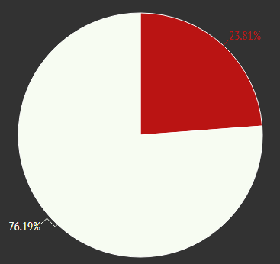


(INCLUDING AFFILIATE: VA, CCHMC, CEI)
N (%) | ASSOCIATE/VICE CHAIRS | BASIC SCIENCE CHAIRS | CLINICAL CHAIRS | DIVISION CHIEFS
FEMALE | 13 (25%) | 0 (0%) | 5 (28%) | 28 (20%) AAMC Benchmark: 24% of division chiefs are women
MALE | 40 (75%) | 3 (100%) | 13 (72%) | 110 (80%)
(N=21)
AAMC Benchmark: 15% of department chairs are women

Slide 15

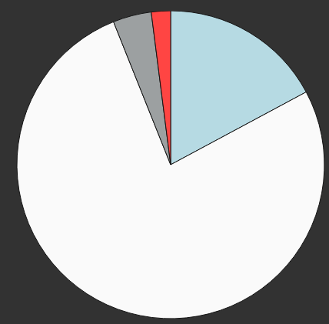
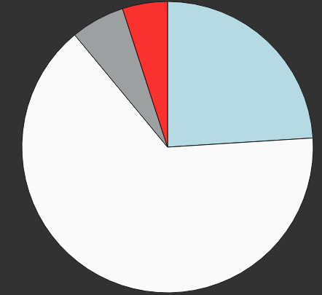
(EXCLUDES AFFILIATE)
FEMALE
MALE
Full: 2%
Full: 5%
Associate: 4%
Instructor: 17%
Associate: 6%
Instructor: 24%
Assistant: 76%
Assistant: 65%
N (%) | INSTRUCTORS | ASSISTANT PROFESSORS | ASSOCIATE PROFESSORS | FULL PROFESSORS
FEMALE | 8 (38%) | 34 (49%) | 2 (40%) | 1 (25%)
MALE | 13 (62%) | 36 (51%) | 3 (60%) | 3 (75%)
Notes:
FEMALE DATA ONLY
NEW HIRES
2016
Instructor: 9(39)
Assistant Professor: 25(46)
Associate Professor: 1(25)
Full Professor: 0(0)
2014
Instructor: 13 (42)
Assistant Professor: 46 (41)
Associate Professor: 6 (55)
Full Professor: 1 (8)
DEPARTURES:
2016
Instructor: 6(32)
Assistant Professor: 15(11)
Associate Professor: 2(3)
Full Professor: 0(0)
2014
Instructor: 5(16)
Assistant Professor: 20(7)
Associate Professor: 7(4)
Full Professor: 6(6)
**Out of all female Associate Professors, n% left UC**

Slide 16

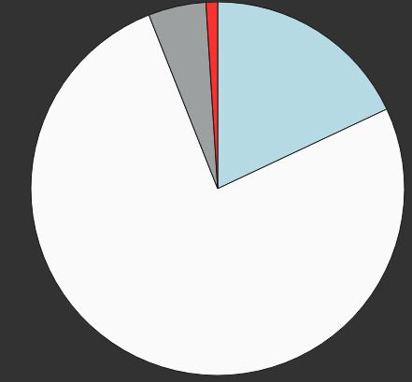
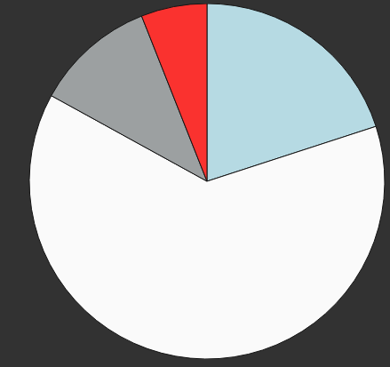
(INCLUDING AFFILIATE: VA, CCHMC, CEI)
FEMALE
Full: 1%
Full: 6%
Associate: 5%
Instructor: 18%
Associate: 11%
Instructor: 20%
Assistant: 76%
Assistant: 63%
N (%) | INSTRUCTORS | ASSISTANT PROFESSORS | ASSOCIATE PROFESSORS | FULL PROFESSORS
FEMALE | 13 (45%) | 56 (52%) | 4 (31%) | 1 (17%)
MALE | 16 (55%) | 52 (48%) | 9 (69%) | 5 (83%)
Notes:
FEMALE DATA ONLY
NEW HIRES
2016
Instructor: 9(39)
Assistant Professor: 25(46)
Associate Professor: 1(25)
Full Professor: 0(0)
2014
Instructor: 13 (42)
Assistant Professor: 46 (41)
Associate Professor: 6 (55)
Full Professor: 1 (8)

Slide 17
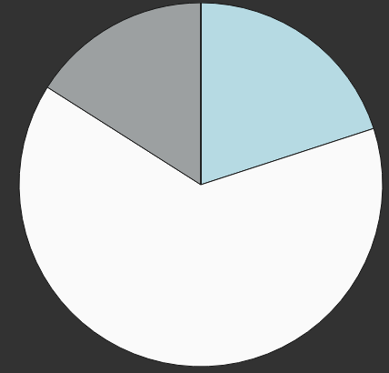
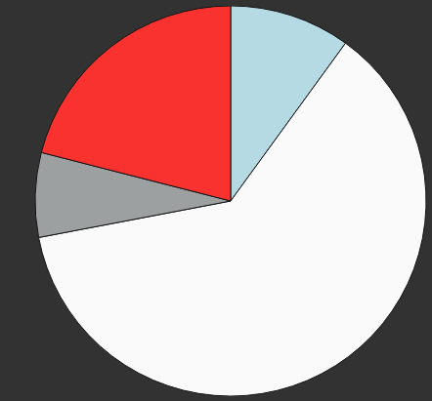
(EXCLUDES AFFILIATE)
FEMALE
MALE
Associate: 16%
Instructor: 20%
Instructor: 10%
Full: 21%
Associate: 7%
Assistant: 64%
Assistant: 62%
N (%) | INSTRUCTORS | ASSISTANT PROFESSORS | ASSOCIATE PROFESSORS | FULL PROFESSORS
FEMALE | 5 (56%) | 16 (38%) | 4 (57%) | 0 (0%)
MALE | 4 (44%) | 26 (62%) | 3 (43%) | 9 (100%)
Notes:
FEMALE DATA ONLY
DEPARTURES:
2016
Instructor: 6(32)
Assistant Professor: 15(11)
Associate Professor: 2(3)
Full Professor: 0(0)
2014
Instructor: 5(16)
Assistant Professor: 20(7)
Associate Professor: 7(4)
Full Professor: 6(6)
**Out of all female Associate Professors, n% left UC**

Slide 18
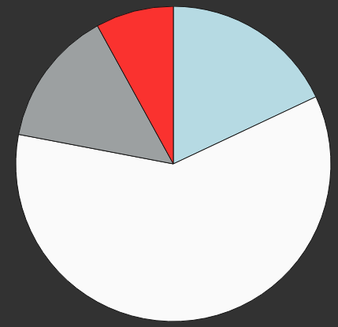
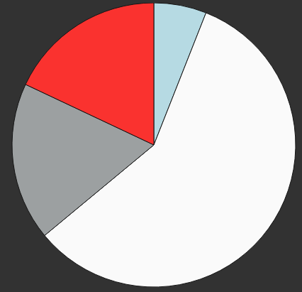
(INCLUDING AFFILIATE: VA, CCHMC, CEI)
FEMALE
MALE
Full: 8%
Instructor: 6%
Instructor: 18%
Full: 18%
Associate: 14%
Associate: 18%
Assistant: 58%
Assistant: 60%
N (%) | INSTRUCTORS | ASSISTANT PROFESSORS | ASSOCIATE PROFESSORS | FULL PROFESSORS
FEMALE | 9 (69%) | 30 (42%) | 7 (35%) | 4 (24%)
MALE | 4 (31%) | 41 (58%) | 13 (65%) | 13 (76%)
Notes:
FEMALE DATA ONLY
DEPARTURES:
2016
Instructor: 6(32)
Assistant Professor: 15(11)
Associate Professor: 2(3)
Full Professor: 0(0)
2014
Instructor: 5(16)
Assistant Professor: 20(7)
Associate Professor: 7(4)
Full Professor: 6(6)
**Out of all female Associate Professors, n% left UC**

Slide 19
NEXT STEPS…
Trends over time (2014, 2016 data)
WIMS Data Annual Report
Alignment with AAMC targets

Slide 20
COM FEMALE Faculty
Focus Group Discussions
Valerie Hardcastle, PhD
Professor, McMicken College of Arts & Sciences

Slide 21
2016 LEAF Survey Results
Women more likely than men to affirm that:
  RPT guidelines do not align with professional aims
  Annual reviews do not help career advancement
  They have had negative work experiences
  (harassment, micro-aggressions, different standards)
  They are not treated respectfully when disagreeing with colleagues
  Their unit’s do not adequately recruit and support women and diverse faculty
  They are satisfied with staff support

Slide 22
2017 Focus Groups
Five Themes Emerged
  A Gendered Work Environment
  A Culture of Silence/Absence of Psychological Safety
  Inconsistent Unit-Level Leadership and Accountability
  Lack of Transparency and Participation in Governance
  Reward System Out-of-Whack

Slide 23
Gendered Work Environment
Vivid examples of interactions with male faculty that could constitute gender discrimination or hostile environment for female faculty
Frustration with ability to confront such behavior or hold instigators responsible
Women faculty perform a larger share of “institutional housekeeping” service work
Perceptions that research and billable time are less protected for women than for men

Slide 24
Culture of Silence
(Absence of Psychological Safety)
Do not feel safe speaking up against decisions being made (e.g., hiring, leadership, environmental concerns, and policy and practice change)
Explicitly told to stay silent
Penalized for speaking up

Slide 25
Inconsistent Unit-Level Leadership and Accountability
Not a gendered issue
Many leaders
  Do not have the support of faculty—even oppose faculty
  Lack a successful track record
  Do not demonstrate support for faculty development
There is no system of accountability
  Chairs/heads have little power
  Not held accountable for supporting faculty needs
  No procedure in place to monitor chair/head performance

Slide 26
Lack of Transparency and Participation in Governance
Faculty Perceive
  Power is held by finance/business area, not heads/chairs
  Decisions are based solely on financial considerations
  There is a top-down hierarchy with little opportunity to provide input on decisions that directly affect work
Administration who focus on diversity and faculty development are in limited roles and unable to fully engage in these matters

Slide 27
Reward System Out-of-Whack
Reward system is inconsistent with RPT criteria and faculty preferences
College funding model places pressure on RVUs
  Less time for patient care
  Less time for research and teaching
Perceives the administration requires faculty to increase college funding at the expense of research, teaching and service missions

Slide 28
Recommendations from Faculty
Require faculty-driven annual reviews for decanal-level and unit head administrators
Adopt a chair/vice chair model (esteemed chair provides vision, vice chair has administrative and interpersonal skills to work with faculty)
Require training to enhance leadership skills of chairs/heads
Seek funding to invest in efforts that support climate change
Better leverage, engage, and reward senior male faculty who advocate for women and URM faculty
Provide follow-up Title IX training for women faculty and students; work with college leaders to limit inadvertently rewarding perpetrators

Slide 29

Faculty Retention
2005 - 2017

Slide 30
Assistant Professors
Gender Differences in Faculty Trajectories

Slide 31
Assistant Professors
2005 - 2017
COM Assistant Professors
UC Assistant Professors
13
387
48
406

Slide 32
Assistant Professor Outcomes
Gender Differences After 7 Years in Rank
COM Women
4
5
4
5
COM Men
18
17
11
2
UC Women
155
132
91
9
6
UC Men
189
137
73
7
Median
years to promotion

Slide 33
Assistant Professors
Race/Ethnicity Differences in Faculty Trajectories

Slide 34
Assistant Professors
2005 - 2017
COM Assistant Professors
UC Assistant Professors
150
25
88
33
522
2

Slide 35
Assistant Professor Outcomes
Race/Ethnicity Differences After 7 Years in Rank
COM Asian
11
8
4
2
4.5
COM URM
2
COM White
5
11
14
8
UC Asian
82
21
2
5.5
45
UC URM
47
23
17
1
6
UC White
204
190
115
13
6
Median
years to promotion

Slide 36
Associate Professors
Gender Differences in Faculty Trajectories

Slide 37
Associate Professors
2005 - 2017
COM Associate Professors
UC Associate Professors
24
292
50
316

Slide 38
Associate Professor Outcomes
Gender Differences After 10 Years in Rank
COM Women
7.5
12
2
9
1
COM Men
6
22
18
9
1
UC Women
6
192
59
39
2
UC Men
191
83
40
2
6
Median
years to promotion

Slide 39
Associate Professors
Race/Ethnicity Differences in Faculty Trajectories

Slide 40
Associate Professors
2005 - 2017
COM Associate Professors
UC Associate Professors
23
100
44
424
53
4

Slide 41
Associate Professor Outcomes
Race/Ethnicity Differences After 10 Years in Rank
COM Asian
4.5
12
7
2
2
COM URM
2
2
6.5
COM White
19
11
14
6.5
UC Asian
63
11
5
24
2
UC URM
32
11
10
7
UC White
261
105
56
2
6
Median
years to promotion

