Slide 1
Welcome to the University of Cincinnati’s Women in Medicine & Science Chapter
Est. 2015
January 25, 2017
MSB-3051

Slide 2
AGENDA ITEMS
Welcome & Call to Order – President, Erin Haynes, DrPH
a. Introduction to Eileen Strempel
Presentation from Eileen Strempel, Senior Vice Provost for Academic Affairs
Website Implementation Update
Please send Dr. Haynes nominations for trainee positions on the WIMS Executive Committee:
a. Postdoctoral Fellow, Clinical Fellow, Medical Student,
Graduate Student, Resident
Upcoming Events
6. Next Meeting: Wednesday, February 15, 2017, noon-1:30 PM, MSB-3051

Slide 3
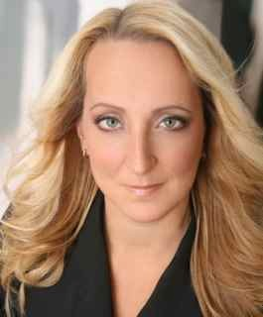
EILEEN STREMPEL, Doctorate of Music
Senior Vice Provost for Academic Affairs

Slide 4
WEBSITE
http://med.uc.edu/WIMS/

Slide 5
EXECUTIVE COMMITTEE TRAINEE POSITIONS
Postdoctoral Fellow
Clinical Fellow
Medical Student
Graduate Student
Resident

Slide 6
UPCOMING EVENTS

