Slide 1
Welcome to the University of Cincinnati’s Women in Medicine & Science Chapter
Est. 2015
October 26, 2016
MSB-2001

Slide 2
AGENDA ITEMS
Welcome & Call to Order – Erin Haynes, DrPH
Committee Updates:
Fundraising – Chair, Florence Rothenberg, MD &
Gabriel Trieger, UC Foundation
b. Mentoring – Chair, Zalfa Abdel-Malek, MD
c. Health Policy – Hala Elnakat Thomas, PhD
RPT Review – Mercedes Falciglia, MD
Upcoming Events

Slide 3
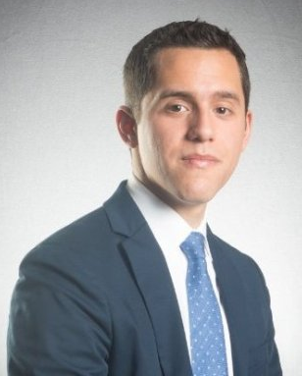
November 16, 2016
8:00 - 9:30 am
Breakfast at the
Kingsgate Marriott
Mt. Echo Room
with Ramón Barthelemy, PhD
Equity in Physics: Understanding the Experiences of Women, LGBT, and Underrepresented Scientists
RSVP Online: http://bit.ly/RamonBarthelemy
Dr. Barthelemy has conducted research on the experiences of women, people of color, and LGBT persons in the STEM fields. His work has identified the many barriers that underrepresented groups face in STEM, with an emphasis on peer-to-peer harassment. He has taken a unique academic approach to teaching STEM students the humanities through an investigation of their own fields.

Slide 4
UPCOMING EVENTS
Next WIMS Meeting: Wednesday, November 30, 2016, noon-1:30 PM, MSB-3051 (trying to get changed to MSB-2001)
LEAF is sponsoring Lynn Gordon, MD, PhD, Senior Associate Dean for Diversity Affairs in the David Geffen School of Medicine at UCLA, to present on Friday, November 4th from 11:30 AM – 1:00 PM.
Dr. Gordon directs the Office of Diversity Affairs, and is currently involved in developing a Diversity Strategic Plan for the College of Medicine.
She currently serves as Chair Elect for the national GWIMS organization through the AAMC
Please contact Emma if you did not receive the calendar invite.

