Slide 1
Women in Medicine & Science University of Cincinnati College of Medicine
April 27, 2016

Slide 2
AGENDA
Call to Order & Introduction – Haynes
Presentation Given by UC Medical Students, Elianna Peak & Sarah Beck – Male vs. Female Faculty Lecturers
Introduction of Committee Chairs:
Mentoring – Chair, Zalfa Abdel-Malek
Data – Chair, Nagla Karim
Fundraising – Chair, Florence Rothenberg
Healthy Policies – Co-Chairs, Jennifer Cavitt & Vinita Takiar
Health Policy Plan – Draft
Other Business: Topics & issues members would like to have included on future agendas
Blackboard: If you do not have access to the WIMS blackboard group, please email Emma (emma.jones@uc.edu) to be added
May 2016 Meeting: TBD

Slide 3
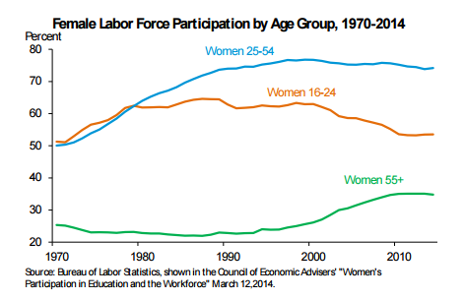
Parental leave is needed
Composition of workforce has changed in last 50 years
Half of the workforce is now women
Dual-earner families must balance work, childcare, and other responsibilities
Currently FMLA (Family and Medical Leave Act) guarantees up to 12 weeks of unpaid leave with employer benefits
Requires employees to have worked for at least 1 year, for at least 1250 hour, at a location with >50 employees
US is 1 of 4 countries in the world without paid maternity leave. Others include:
Lesotho
Swaziland
Papua New Guinea

Slide 4
Need for Maternity/Parental Leave at UC
Leads to decreased faculty satisfaction and retention
Disproportionately affects younger faculty
Forces sick workers who have exhausted leave to show up to work, putting patients and others at risk
Not having a formal leave policy in place results in unequal treatment for individuals with different types of appointments
Adversely affects faculty on tenure clock
➔ Adversely affects tenure prospects for female faculty
➔ contributes to gender gap among senior & tenured faculty

Slide 5
WIMS vision
Make UC the best place for moms/parents to work
Start by establishing a parental leave policy that includes all faculty
UC has an opportunity as a health system to promote health and well being among working parents by leading by example in establishing a universal parental leave policy.
UC can benefit from this policy in the form of improved retention, decreased absenteeism when faculty do return to work, improved faculty morale, & recognition as a leader in healthcare and business.

Slide 6
WIMS vision – Parental Leave Policy
Independent of FMLA
Irrespective of delivery method or adoption
Flexibility of timing (used any time 1st year)
Option to reduce to temporarily PT without decrease in compensation/benefits
Minimum weeks: 12 weeks
Productivity goals (RVUs, collections, grants/pubs, time for tenure) should be adjusted to allow leave
Apply equally to all faculty who have worked >6 months
Benefits (ins premiums) should be covered for all eligible parental leave (paid or unpaid)
To be implemented co-incident, or sooner, with Strategic Plan (2016)

