Slide 1
Do women give lectures in medical school?
GWIMS Presentation April 27th, 2016 Sarah Beck and Elianna Peak UCCOM 2018

Slide 2
Motivation for project
Medical student lunch talks Entering class: 51% female September 2015: 4 of 22 lunch talk speakers 18% October 2015: 9 of 30 lunch talk speakers 30% 4 physicians No Ph.D.s
https://med.uc.edu/medicalstudentadmissions/md-admissions-home/class-profile https://groups.google.com/forum/#!forum/uccom2018 https://en.wikipedia.org/wiki/Solvay_Conference#/media/File:1911_Solvay_conference.jpg

Slide 3
National norms
47% of all enrolled medical students are women 38% of full-time medical school faculty are women 36% of full-time UCCOM faculty are women Is this the whole story? https://www.aamc.org/members/gwims/statistics/ https://en.wikipedia.org/wiki/Joycelyn_Elders#/media/File:Joycelyn_Elders_official_photo_portrait.jpg

Slide 4
Methods
Downloaded from LCMS+
Eliminated non-lecture events
exams
gross anatomy and histology labs
clinical skills workshops
interprofessional experiences
primary care clerkships
small group sessions
online instruction
Grouped lectures by gender of presenter (M/F) and block
Did not separately track Medical Education faculty or block directors

Slide 5
Methods
“Speaker”: person giving presentation, regardless of rank “Lecture”: one session, regardless of length Did not account for non-binary genders M1 data is from 2014-2015 M2 data is from 2015-2016

Slide 6
M1: Fundamentals of Molecular Medicine

Slide 7
M1: Fundamentals of Cellular Medicine

Slide 8
M1: Physician & Society

Slide 9
M1: Musculoskeletal-Integumentary

Slide 10
M1: Gastrointestinal, Endocrine, and Reproductive

Slide 11
“This is not so bad,” you say...

Slide 12
M1 Lecture Topics Across Blocks

Slide 13
M2: Brain, Mind, & Behavior

Slide 14
M2: Hematology & Cardiology

Slide 15
M2: Renal & Pulmonary

Slide 16
M2: Physician & Society

Slide 17
M2: Multisystems

Slide 18
Totals M1 M2

Slide 19
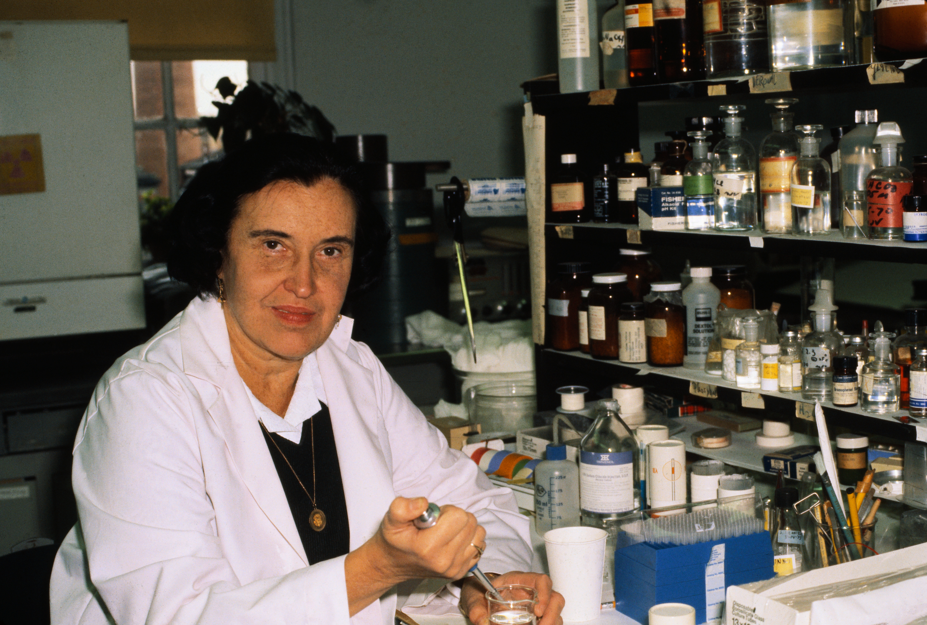
Other remarks
Brain, Mind, and Behavior moving to M1 Medical Education currently seeking new hire “Lectures per woman,” “lectures per man” Cardiology as example http://cdn.history.com/sites/2/2014/01/U1914123.jpg

Slide 20
Questions?
http://s3.amazonaws.com/urbanassembly/schools/UA-Institute-MS.jpg

