Slide 1
Introduction to Trenches & Excavations University of Cincinnati Department of Environmental and Public Health Sciences

Slide 2
Disclaimer
This material was produced under grant number SH-05166-SH9 from the Occupational Safety and Health Administration, U.S. Department of Labor. It does not necessarily reflect the views or policies of the U.S. Department of Labor, nor does mention of trade names, commercial products, or organizations imply endorsement by the U.S. Government.
Notes:
This is the required OSHA Susan Harwood grant disclaimer

Slide 3
Introduction
In this course we will familiarize ourselves with recognizing and avoiding hazards associated with trenches and excavations.
Notes:
The purpose is not to scare you and ensure you never go in a trench or excavation, just to ensure that you are safe when you do.

Slide 4
Learning Objectives
Identify worker rights under the OSH Act
Define 5-10 key terms associated with the hazards and the safeguards of trenches and excavations
Discuss injury and illness statistics for trench and excavation work
Identify and accurately interpret the 6 common trenching and excavation hazards

Slide 5
Learning Objectives
Explain how to identify and avoid trenching and excavation hazards
Identify 3 common forms of cave-in protection
Identify who is responsible for correcting hazards at the site
Explain the benefits of avoiding and correcting hazards

Slide 6
Let’s Test Our Knowledge
Pre-class Quiz

Slide 7
Pre-Assessment (Q1)
Structural ramps used solely by employees as a means of access and egress from excavations shall be designed by a:
Qualified Engineer
Competent Person
Architect
Employees
Notes:
The Answer is B

Slide 8
Pre-Assessment (Q2)
2. Excavations must be inspected daily by an Authorized Person.
True
False
Notes:
The Answer is B

Slide 9
Pre-Assessment (Q3)
3. A “Trench Shield”, commonly known as a “Trench Box” in the field, is an engineered system designed to protect those who are working in a trench.
a. True
b. False
Notes:
The Answer is A
This question may be confusing for students and the instructor should state that a “Trench Shield” is commonly known as, or commonly referred to as a “Trench Box” in the course.

Slide 10
Pre-Assessment (Q4)
4. A Trench and an Excavation is the same thing:
True
False
Notes:
The Answer is B

Slide 11
Pre-Assessment (Q5)
5. Excavations greater than _____ ft. shall be tested before employees enter where potentially ______________ atmospheres could reasonably exist.
4’, Hazardous
4’, Ambient
6’, Hazardous
6’, Ambient
Notes:
The Answer is A

Slide 12
Pre-Assessment (Q6)
6. The bottom of a trench shield (trench box) should be no more than ______ ft. above the bottom of the trench or excavation?
5’
3’
1’
2’
Notes:
The Answer is D

Slide 13
Pre-Assessment (Q7)
7. ___________ cause/causes the most deaths in excavations.
Underground utilities
Water accumulation
Cave ins
Heavy equipment
Notes:
The Answer is C

Slide 14
Pre-Assessment (Q8)
8. In excavations deeper than 4’ a means of exit _________.
Is not needed
Must be located within 100’ of workers
Must be located within 200’ of workers
Must be located within 25’ of workers
Notes:
The Answer is D

Slide 15
Pre-Assessment (Q9)
9. Which of the following statements is not true about Type C soil:
If type is unknown, you should assume all soil is Type C
If sloped, it requires an angle of 34°
It can be benched
Type C soil is usually very loose and prone to cave in
Notes:
The Answer is C

Slide 16
Pre-Assessment (Q10)
10. ______________ involves angling back the material in a continuous plane.
Shoring
Shielding
Sloping
Benching
Notes:
The Answer is C

Slide 17
Worker Duties
Workers have the duty to:
Obey safety regulations
Follow the employer’s health and safety rule
Wear prescribed personal protective equipment while working

Slide 18
Worker Rights
Workers have the right to:
A safe workplace
Certain employer provided information
Make safety complaints
Receive training
Participate in OSHA inspections
Notes:
Workers may request and receive information form the employer on OSHA’s rules and regulations, mandatory measuring or monitoring of toxic substances, and emergency procedures.
They can also make formal complaints in confidence to OSHA, receive OSHA mandated training, and participate in the “walk around” portion of an OSHA inspection.

Slide 19
Worker Rights
Workers have the right to:
Refuse to perform dangerous work
Examine OSHA records
Hazardous chemical information
Medical records
Notes:
Workers may refuse to perform dangerous work if they reasonably believe there is a threat of serious injury or death and the employer refuses to correct the condition after the employee requests it.
They also have access to examine the OSHA 300 log of recordable injuries and illnesses, obtain safety data sheets for hazardous chemicals, and view work-related medical and exposure records.

Slide 20
Worker Rights
Workers have the right to:
Contest the abatement period
Participate in enforcement proceedings
“Whistleblow” on employers
Protection from discrimination
Notes:
Workers have the right to contest an abatement period given to an employer by OSHA, intervene in enforcement proceedings against the employer, and report unsafe conditions or practices to OSHA without fear of retaliation from the employer.

Slide 21
Definition
Excavation:
any man-made cut, cavity, trench, or depression in an earth surface, formed by earth removal
Notes:
This definition is from OSHA.

Slide 22
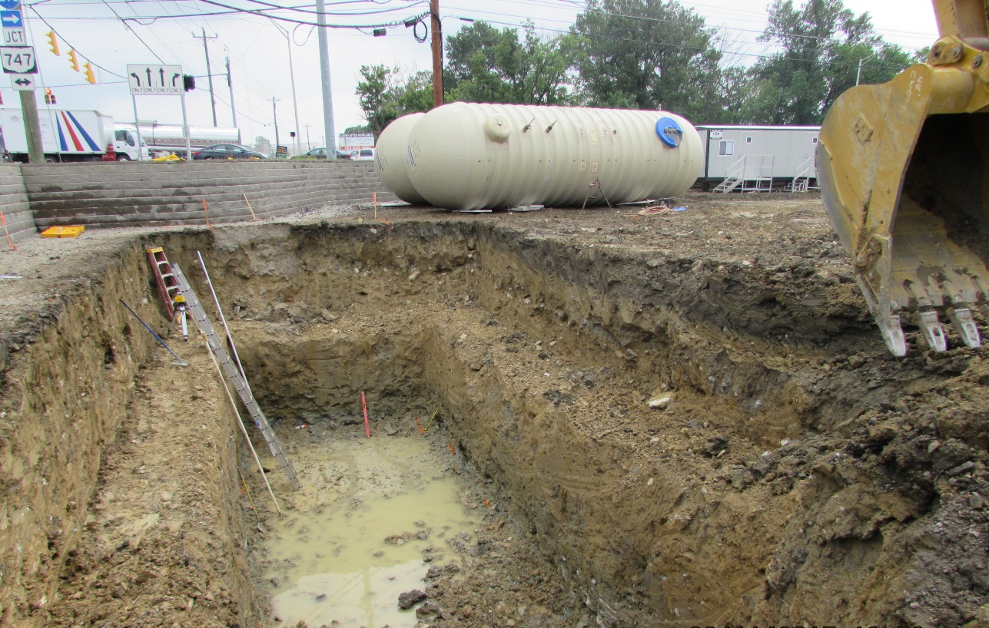
Example
Excavation
Notes:
This is an excavation having water pumped out of it.

Slide 23
Hazards Identified within the Photo
Material/Equipment/Spoils must be kept back 2’
Improper use of a Step-Ladder
Improper Bench
This has caused the slope to become to shear
Improper Ladder Angle
B
Water can not be allowed to pool in the bottom
The first bench has to be double the height to a max of 4’. So if the bench is 4’ (A) tall the width would have to be 8’ (B)
A

Slide 24
Definition
Trench (or trench excavation):
a narrow excavation (in relation to its length) made below the surface of the ground.
generally deeper than it is wide, but not more than 15 ft. wide at the bottom.
can also be made by having forms or other structures inside an excavation.
Notes:
This definition is from OSHA. A trench is generally deeper than it is wide, but not more than 15 ft. wide at the bottom. A trench can also be made by having forms or other structures inside an excavation.

Slide 25
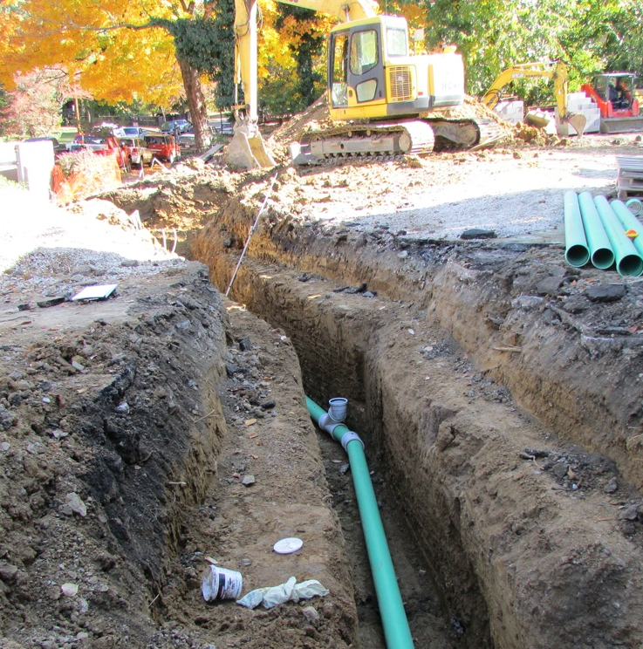
Examples
Trench for water line
Trench for conduit
Notes:
Photo on the left used with permission from David Ponder.
Photo on the right used with permission from Benjamin Yaney.

Slide 26
Definition
Cave-in:
separation of a mass of soil or rock material from the side of an excavation….in sufficient quantity so that it could entrap, bury, or otherwise injure and immobilize a person
Notes:
The full OSHA definition includes “the loss of soil from under a trench shield or support system, and its sudden movement into the excavation, either by falling or sliding”

Slide 27
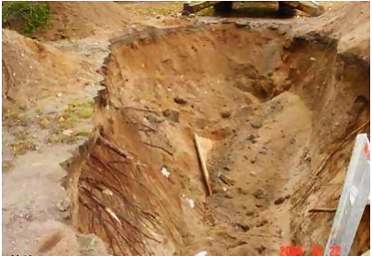
Example
Cave-in
This image courtesy of NIOSH Michigan
Notes:
This was a trench that had caved in.
Photo credit – NIOSH Michigan Case Report: 04MI160. http://www.cdc.gov/niosh/face/stateface/mi/04mi160.html

Slide 28
Definition
Hazardous atmosphere:
an atmosphere which by reason of being explosive, flammable, poisonous, corrosive, oxidizing, irritating, oxygen deficient, toxic, or otherwise harmful, may cause death, illness, or injury
Notes:
This definition is from OSHA. An example of a hazardous atmosphere would be carbon monoxide from vehicle or fueled equipment exhaust.

Slide 29
Definition
Protective system:
a method of protecting employees from cave-ins, from material that could fall or roll from an excavation face or into an excavation, or from the collapse of adjacent structures.
Notes:
This definition is from OSHA. OSHA also says that “Protective systems include support systems, sloping and benching systems, shield systems, and other systems that provide the necessary protection.”

Slide 30
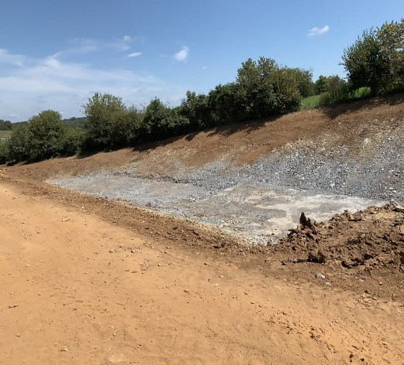
Examples
Shoring
Protective systems:
Shielding
Sloping
Notes:
Left photo-an example of sloping the walls/faces of an excavation to eliminate the potential for cave-ins.
Photo used with permission from Benjamin Yaney.
Center photo-an example of shielding, using a trench box to protect the workers inside from the walls caving-in.
Shielding photo credit – David Ponder.
Right photo-an example of hydraulic shoring. Its purpose is bracing the walls of a trench excavation to support them, so they don’t cave-in.
Shoring photo credit – David Ponder.

Slide 31
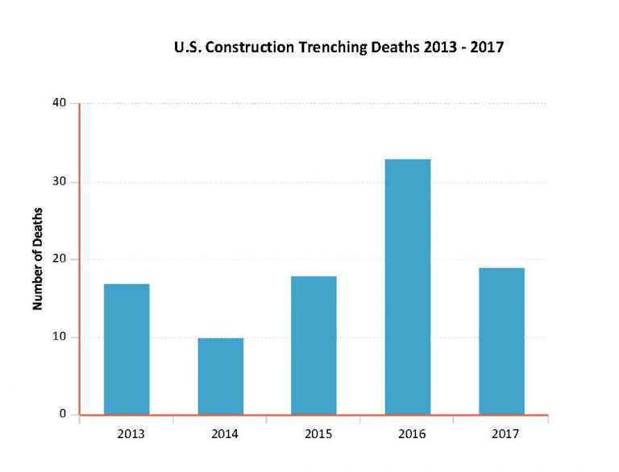
Statistics & Data
Injuries/Year:
Trench fatalities
This image courtesy of BLS.
Notes:
This data from the Bureau of Labor Statistics shows the number of fatalities in construction trenching and excavation work from 2013 to 2017, a five-year period. It is not an insignificant number-in 2016 there was a death an average of every other week. Many OSHA education and training groups focus on falls and excavation and trenching safety as they assist employers.

Slide 32
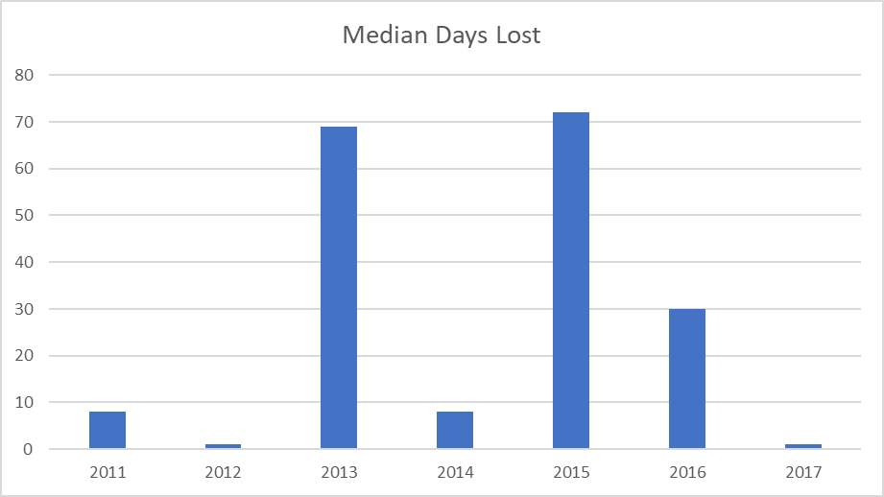
Statistics & Data
Trench & Excavation Median Days Lost
This image courtesy of BLS.
Notes:
This data from the Bureau of Labor Statistics concerns serious injuries over a 7-year period. Median days lost is a metric indicating the relative severity of injuries and 3 of the 7 years show a median of 30 or more days off for trenching and excavation injuries. The impact of any serious injury is great on the injured employee and the company, but imagine your coworker getting hurt so seriously that it takes a couple months before they can work again. Do you think they’ll be itching to get back in a trench or excavation?

Slide 33
Statistics & Data
Non-fatal Injury Types:
Avulsion
Concussion
Crushing Injury
Cut, laceration
Joint Dislocation
Fracture
Internal injuries
Intracranial
Puncture
Soreness
Pain
Traumatic
Notes:
This list from OSHA’s online severe injury reports specifies 12 different types of injuries reported from trench and excavation work in 81 serious injuries since 2015. The most commonly occurring are fractures, then soreness, traumatic, internal and concussion injuries.

Slide 34
Statistics & Data
Non-fatal Injury Events:
Cave-in
Fall through surface
Fall to lower level
Fall from collapsing structure
Fall on same level
Slipping
Jump over or to a location
Notes:
This list from OSHA’s online severe injury reports show 7 different types of events that led to 81 serious injuries since 2015. All events have to do with walking/working surfaces or cave-ins. A fall into a trench that is 6 ft. or deeper is also a fall to lower level injury. It is safe to assume that some falls from heights or onto lower levels and some falls into excavations are placed into only one of the categories, thus showing less occurrence in records than.
Looking at the numbers, from 2015-2017 there averaged a little over 20 fatalities while there averaged a little under 20 serious injuries per year. What that tells us is that cave-in and falling hazards should always be corrected because over half the serious injuries are likely to result in death.

Slide 35
Statistics & Data
Citations & costs:
Standard | # of Citations | Penalty Amount
1926.651 Specific Excavation Requirements | 795 | $3.4M
1926.652 Requirements of Protective Systems | 613 | $4.2M
This data courtesy of OSHA (cited by Federal OSHA during the period October 2018 through September 2019. Penalties shown reflect current rather than initial amounts.)
Notes:
This table shows the direct cost to employers for not following regulations in 1926.651 and 652-over $7.5M for the period between October 2018 through September 2019! This is but one aspect of cost when it comes to unsafe trench and excavation work. Other costs include:
Medical costs for injuries
Additional labor and training after an injury
Lost productivity, morale
Increased overhead
Insurance costs
Lost earnings

Slide 36
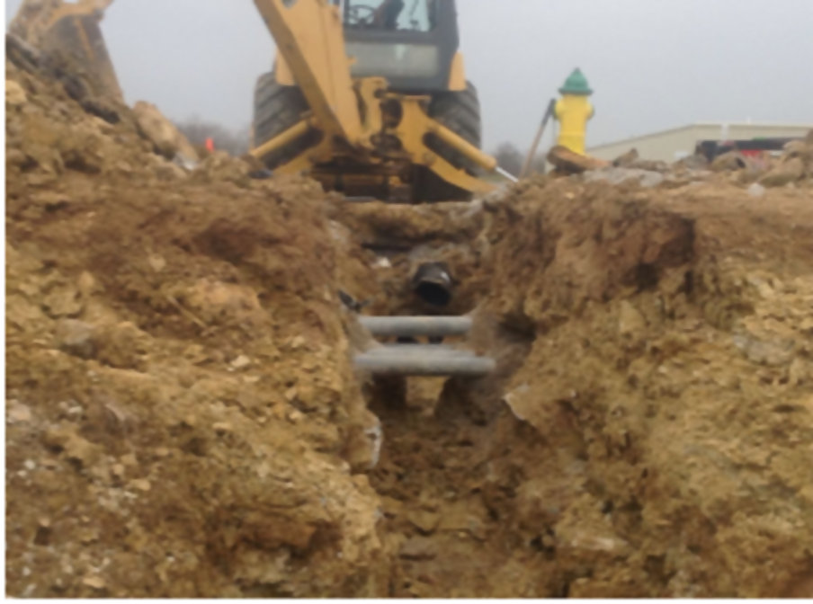
Common Hazards
Underground utilities
Natural gas
Sewer
Water
Electric
Communication
Stormwater
Notes:
Underground utilities-damaged underground utilities can be costly and slow to repair and can carry some of the following hazards:
Natural gas-explosive, flammable, displaces oxygen
Sewer-toxic
Water-weakens excavation walls, is a drowning hazard, can impede egressing the trench
Electric-electrocution
Communication-electrocution
Stormwater-can hamper erosion control, is a drowning hazard, and may carry chemicals
Photo-an example of a broken water line.
Photo used with permission from Benjamin Yaney.

Slide 37
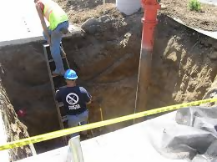
Common Hazards
Access & egress
No close evacuation during emergencies
Slipping, tripping or falling
Entrance or exit ramp improperly designed
Equipment entering or leaving
This image courtesy of MNOSHA.
Notes:
Access & egress-not having a safe way into or out of an excavation is a hazard.
If workers need to evacuate an excavation, their exit cannot be a hundred feet away because it would take too long for them to get out.
Workers cannot be expected to climb out of a trench using the walls, utilities or other equipment-they could easily trip, slip or fall and get injured.
If the means of entrance or exit is not designed correctly and fails, workers could get crushed or pinned by soil or equipment.
Photo credit – MNOSHA
https://dli.mn.gov/sites/default/files/pdf/construc_sem_excavation_trenching_0317.pdf

Slide 38
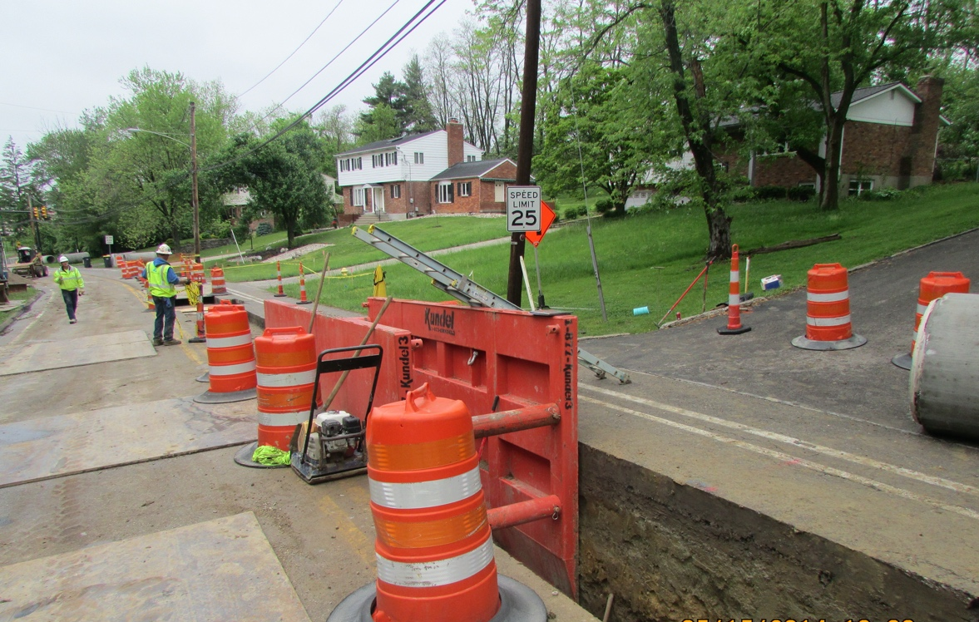
Common Hazards
Equipment & vehicular
traffic
Accidental vehicle entry
Falling loads
Struck while loading or unloading
Notes:
Equipment & vehicular traffic-vehicles around trenches and excavations are also hazards. This may include traffic as well as equipment on the job site.
Any vehicle accidentally entering a trench or excavation is bad for the driver and anyone working in the area.
Soil, rocks or other debris that is removed from the excavation can fall and cause injuries to workers nearby.
Many times, it can be difficult for equipment operators to be aware of who is in their work area because they are focused on what they are working on. Trenches and excavations can also be small, crowded spaces, so struck by hazards are likely to be present.
Photo used with permission from David Ponder.

Slide 39
Common Hazards
Hazardous atmosphere
Lack of oxygen
Flammable, explosive or toxic air
Lack of rescue equipment
Notes:
Hazardous atmosphere-vapors, dust or fumes in the air can displace oxygen, be toxic to breathe or may ignite and burn or explode. Knowing what might be in the atmosphere will help workers know what hazards might exist. If hazardous atmospheres are present, a lack of rescue plan or equipment is a hazard as well.

Slide 40
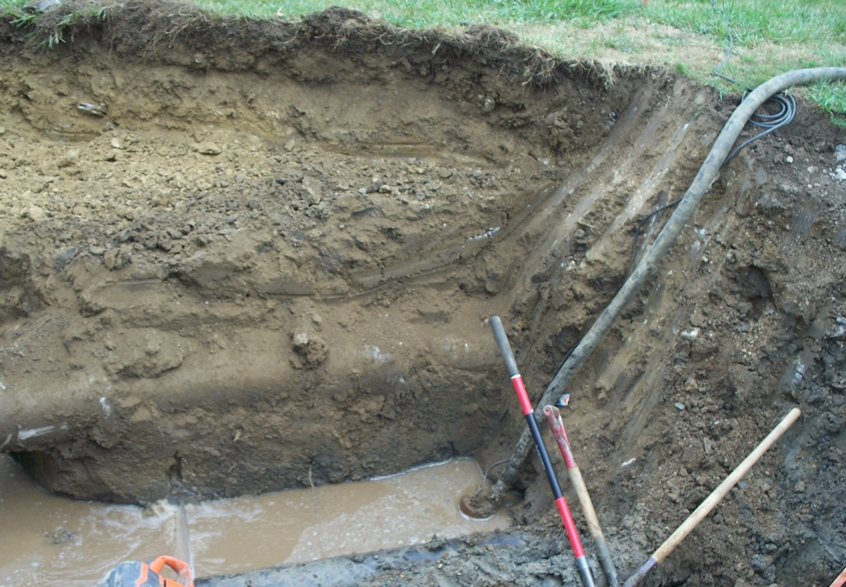
Common Hazards
Water accumulation
Drowning hazard
Slipping hazard
Electrical
Egress and stability hazard
Notes:
Water accumulation-excavations with accumulated or accumulating water or that are saturated are hazardous for workers.
If the water is deep enough, workers could drown if they fall, get stuck or can’t swim.
Wet work areas always have slip hazards, and especially in trenches and excavations due to the uneven ground and likelihood of slick surfaces.
Water in an excavation may cause electrical tools and equipment to short out or not be sufficiently grounded, which are risks to workers.
Saturated soil can impede workers from exiting an excavation. It also has less supportive strength and can cause walls or other features to fail.
Photo used with permission from David Ponder.

Slide 41
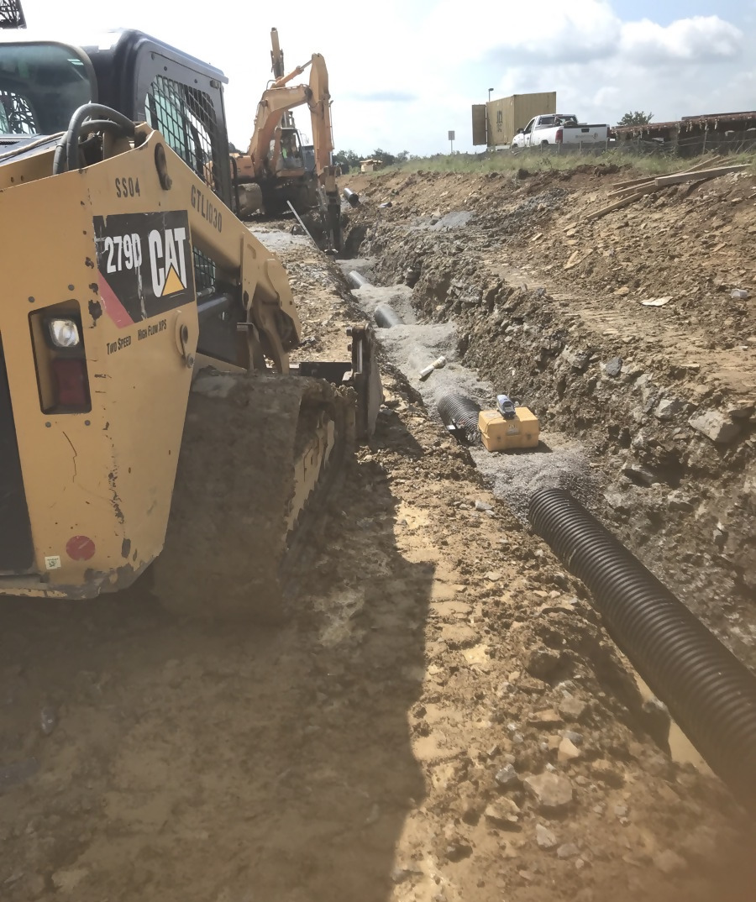
Common Hazards
Stability
Loose soil or rock along edges
Surface encumbrances
Cave-ins
Notes:
Stability-there are inherent stability hazards in every excavation just due to the nature of digging in the ground.
Loose soil or rocks along the edges of excavations can fall and injure workers below.
Surface encumbrances are any nearby structures that can become unstable due to the excavation-this can include trees, sidewalks, utility poles, or buildings for example. If any of those were to fall, slide, break or move unintentionally then workers nearby could get hurt.
Cave-ins are generally the most serious hazard associated with excavations and trenches.
Photo used with permission from Benjamin Yaney.

Slide 42
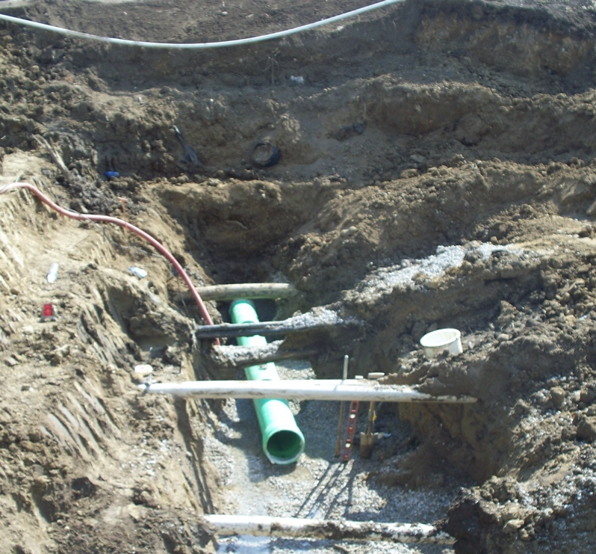
Avoiding Hazards
Locating and protecting utilities
Call 811 and have utilities marked
Use other detection methods (eg. Potholing)
Support/protect once uncovered
Notes:
Locating utilities--to prevent damage to underground installations, follow these three steps:
Have utility companies locate and mark the utilities in the area where work is proposed
If they cannot be located or marked, “pot hole” or use other detection methods to locate the utility. Pot holing is digging a small hole carefully and incrementally to find an underground utility that hasn’t been marked or had its location verified. Once uncovered, the location can be extrapolated. It may take multiple pot holes to accomplish this.
When a utility is uncovered and inside an excavation, it must be supported, protected or removed as necessary to ensure worker safety.
Photo credit- David Ponder

Slide 43
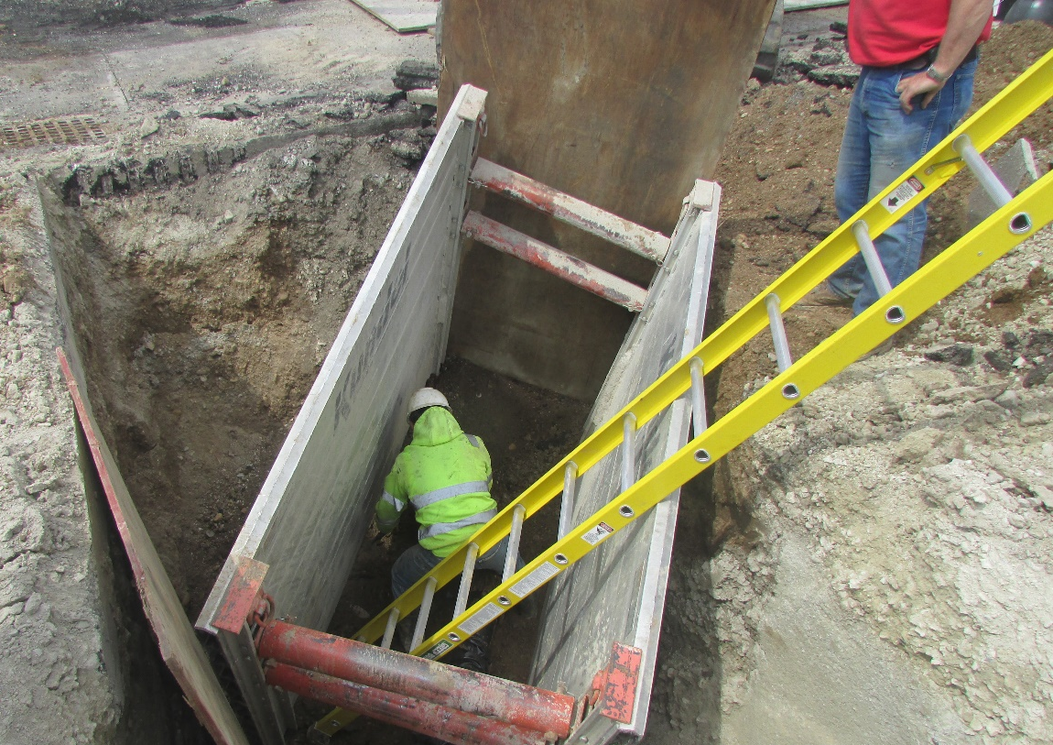
Avoiding Hazards
Ladders and ramps
Exits located within 25 lateral feet
Ladders secured and extended
Ramps designed by competent person
Internal traffic control plan
Notes:
Ladders and ramps-proper ladder placement, ramp design and internal traffic control will eliminate many access and egress hazards.
All egress points must be located so that an employee in any part of the trench can reach one within 25 ft. of lateral movement. Ladders must be secured and extend at least 3 ft. above the excavation. If a ramp is used for equipment, it must be designed by a competent person qualified in structural design and there should be a traffic control plan if it will also be used by pedestrians.
This is a photo of a ladder inside of a trench box and extended above the trench.
Photo credit-David Ponder.

Slide 44
Avoiding Hazards
Exposure controls & warning systems (concerning vehicles & equipment)
High viz clothing
Flag person, signs, barricades
Nobody permitted under loads
Edge barricades, stop logs, etc.
Notes:
Exposure control and warning systems-these methods will reduce hazards for workers that come from traffic and equipment.
If an excavation is in a traffic area, workers must wear high visibility, reflective clothing. If the trench or excavation reroutes traffic, then a proper flagger, signs, and barricades designated in the Manual on Uniform Traffic Control Devices (MUTCD) must be in place to do so safely.
No workers are permitted underneath digging and excavating loads. Also, barricades or stop devices such as logs, berms, etc. must be in place along the edge of an excavation if operators do not have a clear view of the edge.

Slide 45
Avoiding Hazards
Testing and controls (concerning atmospheres)
Test for:
Oxygen
Flammables
Toxic substance
Control via:
Ventilation
Respirators
Rescue
Notes:
Testing and controls-verifying what is present in an excavation atmosphere and controlling exposure to it helps workers avoid potential hazards.
A four-gas monitor is a good testing device to determine if there is lack of oxygen or presence of common flammable or toxic fumes in an atmosphere. Often, ventilation in the form of air movers is enough to remove the bad stuff and supply fresh air. If more protection is needed, workers will need to wear respirators to keep them from breathing the fumes or to supply fresh air if necessary. When a hazardous atmosphere exists, rescue equipment and trained personnel must be available and prepared to perform rescues for workers in the excavation.

Slide 46
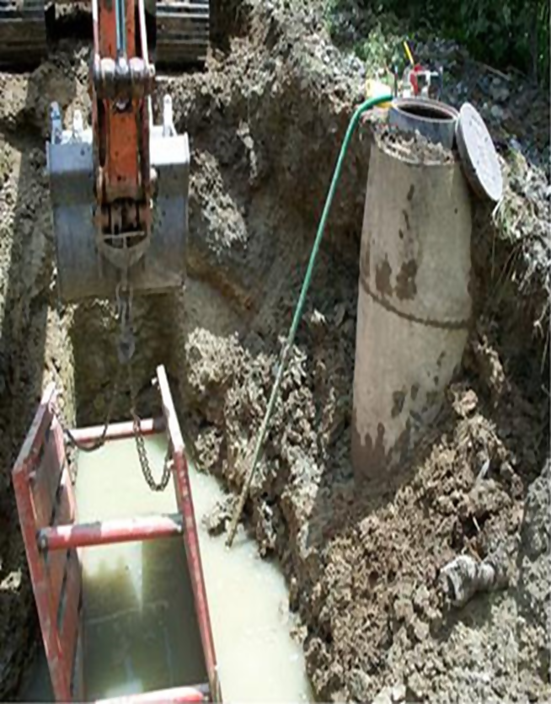
Avoiding Hazards
Dealing with water
Pump it out
Naturally dry out
Protection for electrical
This image courtesy of OSHA.
Notes:
Dealing with water-water accumulation in an excavation brings a few hazards with it.
Water can often be pumped out of an excavation to get rid of the drowning hazard, but it is likely that slip hazards and egress hazards will remain on wet and saturated surfaces. Natural drying out of the trench is the most complete way to solve those problems.
Water can also cause electrical tools and equipment to short out, but sometimes electrical components can be covered or protected with tarps, plastic or other impermeable material to keep them dry and usable.
Photo credit-OSHA.

Slide 47
Hazards Identified within the Photo
Improper slope
Unprotected hole
Permit Required Confined Space
Trench height greater than 18” from top of box
No access or egress
Training, competent person and inspection seem to be missing
Distance from the excavation wall to the trench box is greater
than expected surcharge.
Water pooled inside the trench

Slide 48
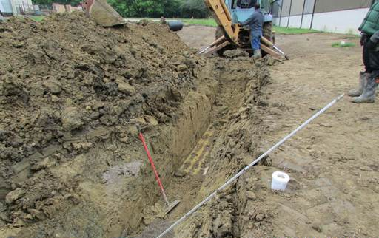
Avoiding Hazards
Soil support
Spoil pile location
Remove loose rocks
Support structures
Protective systems
Notes:
Soil support-placing and supporting soil in a safe manner is essential for worker safety in excavations. One cubic foot of soil can weigh 100 lbs. and one cubic yard can weigh 2700 lbs.
It starts with placing spoil piles at least 2 ft. from the edge to reduce pressure on the excavation walls. Then, loose rocks or chunks of soil should be knocked down prior to workers entering so that they do not fall on workers. Next, structures in the area need to be supported correctly so they stay in place and do not fall. Bracing, tying down and jacking are some methods to add support to structures.
Finally, protective systems to prevent cave-ins is the most critical type of soil support. These include sloping and benching, support systems such as shoring, bracing and underpinning, as well as shielding. These are always required unless the excavation is in stable rock or less than 5 ft. depth. We will go into a little more detail on those in the next slides.
Photo shows spoils located within 2 ft. of the trench edge.
Photo credit-David Ponder.

Slide 49
Hazards Identified within the Photo
Spoils must be kept back 2’
Sidwalls appear to be 5’ feet deep with no protection

Slide 50
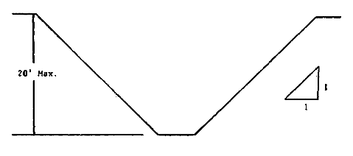
Cave-in Protection
Sloping:
3/4:1 – 1.5:1 depending on soil type
Image Courtesy of OSHA
Notes:
Sloping and benching-this technique uses geometry to reduce the likelihood of cave-ins and is good for cohesive type A or B soil. Slopes can vary from ¾:1 to 1.5:1 depending on soil type. Benching typically stays at a 1:1 ratio. These forms of protection are cost effective but do require additional space around the excavation or trench to perform.
Sloping a ten-foot-deep excavation/trench makes the area much wider, but eliminates the potential for a cave-in.
Photo credit-David Ponder.

Slide 51
Cave-in Protection Maximum Allowable Slopes
Soil or Rock Type | Maximum Allowable Slopes (H:V)(1) For Excavations Less Than 20 Feet Deep(3)
STABLE ROCK TYPE A (2) TYPE B TYPE C | VERTICAL (90º) 3/4:1 (53º) 1:1 (45º) 1 ½:1 (34º)
Table Courtesy of OSHA
Notes:
Configurations of sloping and benching systems shall be in accordance with Figure B-1.
Footnote(1) Numbers shown in parentheses next to maximum allowable slopes are angles expressed in degrees from the horizontal. Angles have been rounded off. Footnote(2) A short-term maximum allowable slope of 1/2H:1V (63º) is allowed in excavations in Type A soil that are 12 feet (3.67 m) or less in depth. Short-term maximum allowable slopes for excavations greater than 12 feet (3.67 m) in depth shall be 3/4H:1V (53º). Footnote(3) Sloping or benching for excavations greater than 20 feet deep shall be designed by a registered professional engineer.

Slide 52
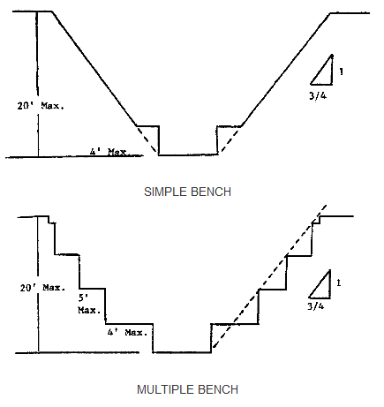
Cave-in Protection
Benching
Excavations 20 feet or less in depth shall have a maximum allowable slope of 1:1 and maximum bench dimensions as follows:
Image Courtesy of OSHA
Notes:
Benching, excavations 20 feet or less in depth shall have a maximum allowable slope of 1:1 and maximum bench dimensions as follows:

Slide 53
Cave-in Protection
Shoring types:
Aluminum hydraulic
Timber
Install from top down
Remove from bottom up
Notes:
Shoring-timber shoring and aluminum hydraulic shoring are designed to prevent movement of soil, roadways, foundations and utilities. Aluminum hydraulic is the best because it can be installed by one worker and they do not need to enter the trench to install it. It does need to be inspected each day for leaks, damage, broken connections, etc.
The photo shows how shoring can be used in very tight excavations.
Photo credit-David Ponder.

Slide 54
Cave-in Protection
Shielding (boxing):
Trench boxes backfilled to prevent movement
Notes:
Shielding-trench boxes are the primary form of shielding and are not designed to support the excavation, but protect the workers inside the box from cave-ins. They must be backfilled to prevent movement and if they are not large enough for the whole trench or site, must be moved often.
The photo shows a long trench box, but they come in all kinds of shapes and sizes.
Photo credit-David Ponder.

Slide 55
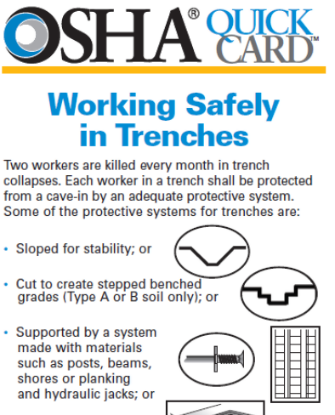
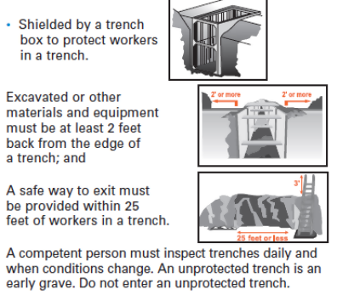
Cave-in Protection
These images courtesy of OSHA Trench Safety Tips
Notes:
This is OSHA’s quick card for trench safety.
Photo credit – OSHA Trench Safety Tips.
https://www.osha.gov/Publications/trench/trench_safety_tips_card.html

Slide 56
Responsibilities and Benefits
Workers:
Report unsafe observations
Follow safety rules and regulations
Maintain their health and safety
Improve safety culture and practices
Notes:
Responsibilities-workers are responsible to report unsafe observations and follow safety rules and regulations.
Benefits-workers benefit by maintaining their health and safety and improving the safety culture and practices of their company, making them more valuable.

Slide 57
Responsibilities and Benefits
Employers:
Provide competent person
Strive for OSHA compliance, & correct known hazards
Avoid costs associated with injuries & have a productive workforce
Notes:
Responsibilities-employers must provide a competent person for trench and excavation work and ensure that OSHA compliance is met. They must correct known hazards.
Benefits-employers benefit by having a healthy workforce, avoiding the costs of injuries and lost time and by having a good safety culture. The workforce is more productive and produce quality work when it is safe.

Slide 58
Review
Describe some worker duties
Describe some worker rights
Define some key terms
Name some excavation & trench hazards
Describe how to avoid those hazards
Notes:
Spend a few minutes reviewing materials, ensuring the learning objectives are met.

Slide 59
Review
6. Name the three main forms of cave-in protection
7. Name some responsibilities and benefits of correcting and avoiding hazards
a. for workers
b. for employers
Notes:
Spend a few minutes reviewing materials, ensuring the learning objectives are met.

Slide 60
Let’s Test Our Knowledge
Post-class Quiz

Slide 61
Post-Assessment (Q1)
Structural ramps used solely by employees as a means of access and egress from excavations shall be designed by a:
Qualified Engineer
Competent Person
Architect
Employees
Notes:
The Answer is B

Slide 62
Post-Assessment (Q2)
2. Excavations must be inspected daily by an Authorized Person.
True
False
Notes:
The Answer is B

Slide 63
Post-Assessment (Q3)
3. A “Trench Shield”, commonly known as a “Trench Box” in the field, is an engineered system designed to protect those who are working in a trench.
a. True
b. False
Notes:
The Answer is A
This question may be confusing for students and the instructor should state that a “Trench Shield” is commonly known as, or commonly referred to as a “Trench Box” in the course.

Slide 64
Post-Assessment (Q4)
4. A Trench and an Excavation is the same thing:
True
False
Notes:
The Answer is B

Slide 65
Post-Assessment (Q5)
5. Excavations greater than _____ ft. shall be tested before employees enter where potentially ______________ atmospheres could reasonably exist.
4’, Hazardous
4’, Ambient
6’, Hazardous
6’, Ambient
Notes:
The Answer is A

Slide 66
Post-Assessment (Q6)
6. The bottom of a trench shield (trench box) should be no more than ______ ft. above the bottom of the trench or excavation?
5’
3’
1’
2’
Notes:
The Answer is D

Slide 67
Post-Assessment (Q7)
7. ___________ cause/causes the most deaths in excavations.
Underground utilities
Water accumulation
Cave ins
Heavy equipment
Notes:
The Answer is C

Slide 68
Post-Assessment (Q8)
8. In excavations deeper than 4’ a means of exit _________.
Is not needed
Must be located within 100’ of workers
Must be located within 200’ of workers
Must be located within 25’ of workers
Notes:
The Answer is D

Slide 69
Post-Assessment (Q9)
9. Which of the following statements is not true about Type C soil:
If type is unknown, you should assume all soil is Type C
If sloped, it requires an angle of 34°
It can be benched
Type C soil is usually very loose and prone to cave in
Notes:
The Answer is C

Slide 70
Post-Assessment (Q10)
10. ______________ involves angling back the material in a continuous plane.
Shoring
Shielding
Sloping
Benching
Notes:
The Answer is C

Slide 71
References
WeeklySafety.com, Excavation Safety-https://weeklysafety.com/topic-categories/excavation-safety
Occupational Safety & Health Administration(OSHA), Trenching & Excavation Hazards & Solutions-https://www.osha.gov/SLTC/trenchingexcavation/solutions.html
OSHA, Worker Safety Series-https://www.osha.gov/Publications/OSHA3252/3252.html
OSHA Regulations, 1926.650-https://www.osha.gov/laws-regs/regulations/standardnumber/1926

