Slide 1

Getting Help With Research!
_{Brett Kissela, MD, MS}
_{Professor and Chair}
Department of Neurology and Rehabilitation Medicine
Senior Associate Dean of Clinical Research
University of Cincinnati College of Medicine
Chief of Research Services, UC Health

Slide 2
Center for Clinical and Translational Science and Training (CCTST)
James E. Heubi, M.D
Director, CCTST
Brett Kissela, MD, MS
Multiple PI

Slide 3
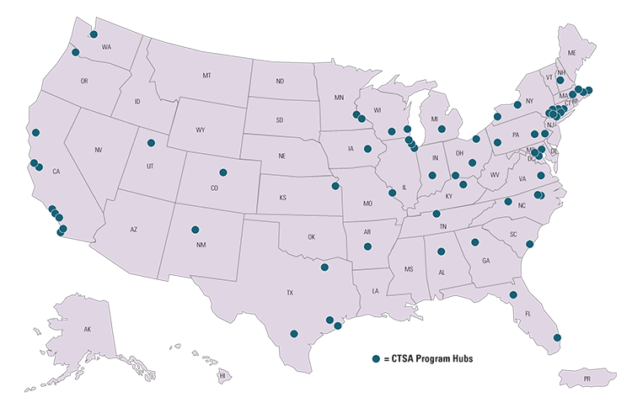
CCTST
Institutional CTSA funded since 2009 ($4.2M annual total costs + equal institutional match)
Partnership among
  University of Cincinnati
  Cincinnati Children’s Hospital Medical Center
  Cincinnati VA Medical Center
  UC Health
  Greater Cincinnati Community

Slide 4
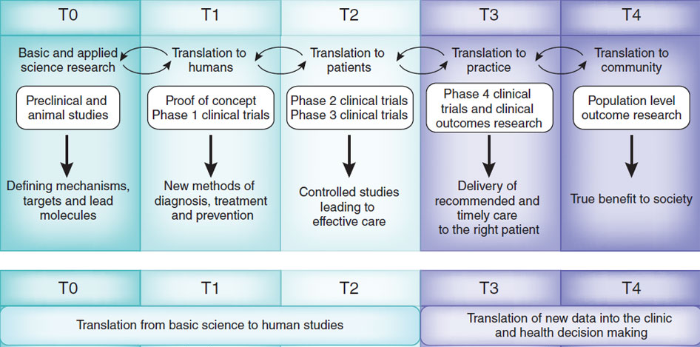
Operational Phases of Translational Research
Adapted from Blumberg RS, et al. Nat Med. 2012; 18:35–41.

Slide 5

CCTST created 2005
CTSA Funded April 2009
  Funding cycle: April 1-March 30
Renewal/New grant funded August 14, 2015
  Four years funding through March 31, 2019
  Competitive renewal submitted May 25, 2018

Slide 6
CCTST
Serves as the academic home for clinical and translational research
Provides research support for approx. 3,600 academic and community members
Provides grants to dozens of researchers and community members each year
Support salaries of approx. 140 faculty and staff

Slide 7
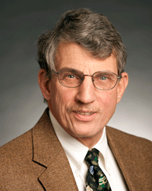
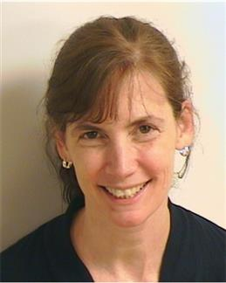
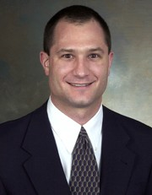
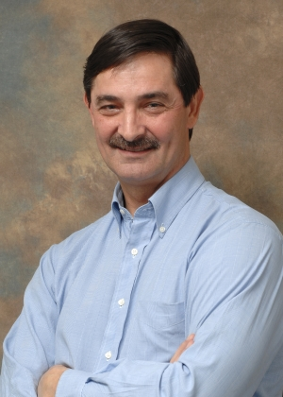
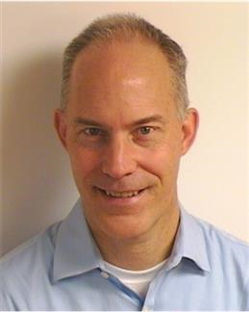
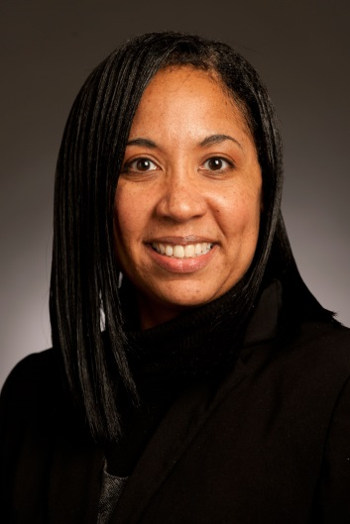
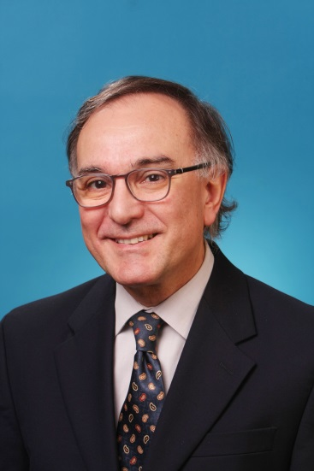
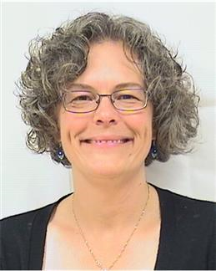
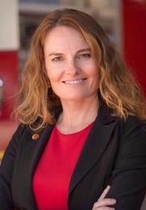
Leadership (Executive Committee)

Slide 8
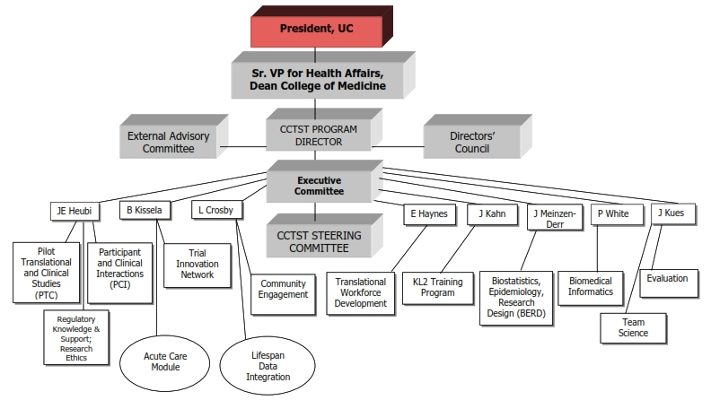

Slide 9
CCTST Services
Biomedical Informatics
  REDCap for data entry/collection/surveys
  Data warehouse services (i2b2)
Biostatistics, Epidemiology, and Research Design (BERD)
Regulatory Knowledge & Support
Pilot Programs
  Pilot Translational/Mentored Pilot Translational/Cores, Just in Time, Processes/Methods
Participant and Clinical Interactions
  Location T (Cincinnati Children’s)
  VA
Notes:
I2b2=informatics for integrating biology to bedside

Slide 10
CCTST Services
Community Engagement and Research
  PBRN
  CBPR
  Community Leaders Institute
  Community Health Grants
Translational Workforce Development
  MS in Clinical and Translational Research
  Certificate in Clinical and Translational Research
  Fellows ACGME curriculum
  PhD in Biomedical Informatics
  CCTST Grand Rounds
Notes:
KL2 = mentored career development award. Can only be disaggregated from a U54 application

Slide 11
CCTST Services
Acute Care Research Core
  Acute Care Research Council
  Consultations
  Coordinator sharing?
Trial Innovation Network
  TICS—coordinating center function
  RICS—recruitment via EHR, community engagement
Notes:
KL2 = mentored career development award. Can only be disaggregated from a U54 application

Slide 12
Career Development
KL2 program
  4 Scholars at a given time
  2-year appointments with 3rd year guarantee by home department
  K Scholars meetings
  K Club

Slide 13
Selected Accomplishments
Refocused Research Central, to provide more focused services comprehensive services since renewal with award of 60 vouchers leading to 30 grant applications with $4.25 in awards to date
CCTST Integration Committee has served 92 faculty from multiple UC Colleges, CCHMC, UC Health and VAMC to help investigators, identify and overcome barriers, help form multidisciplinary teams, and provide ongoing support with excellent feedback.
Created Community Leaders Institute, a 6-week training program for community leaders with 133 graduates obtaining >$5 M in grants (ROI> 28). Now implemented at 3 other hubs.
Completed member survey to determine satisfaction with services and challenges that CCTST could help with solutions
Center for Improvement Science initiated series of workshops, approved team science course for MS and Certificate in CTR

Slide 14
Selected Accomplishments
Graduated over 161 students from the CCTST-supported MS in CTR and 121 from Certificate in CTR programs
MS and Certificate students have published nearly 4,000 papers and obtained over $140M in research grants
All KL2 scholars pursuing academic careers
Fostered closer relationships between Greater Cincinnati community hospital IRBs with common training in ethics, templates for informed consent, and an IRB reliance agreement
Pilot/core programs made grants of $8.8 M to foster collaboration between investigators leading to >$125 M in extramural grants (ROI: 14.6).
Community Health Grants: 54 grants with 7 publications and $6.8M grants (ROI: 11.1)
Developed Department of BMI and implement PhD program in 2016
Implemented PhD in Biomedical Informatics in 2016
Developed comprehensive internal grant catalogue

Slide 15
Vision and Aims for CTSA Renewal
    Aim 1: Empower stakeholders in the process of integrating research with healthcare practice and community wellness
Aim 2: Create the workforce of the future
Aim 3: Optimize efficiency and effectiveness of clinical research

Slide 16
Components
Overall
Administration
  Evaluation
Translational Science Base (TSB)
Research Expertise and Methods(REM)
Research Implementation and Participation (RIP)
Network Resources and Optional Modules (NRO)
Mentored Career Development (KL2)
NRSA Training Core (TL1)

Slide 17


Submission Timeline
Target Submission Date
May 25th
Identify Core Team
Kickoff
Meeting
Develop writing teams for each core area
EAC Visit
Grant themes and writing strategies
Grant
Submission
Deadline
Draft for
EAC Review
Draft
Budget
Review
EAC
Report
Revised draft of budget
Full Draft
External readers/ review
Final
Budget
Final
Draft
1
2
3
4
5
6
7
8
9
10
Member Survey
Stakeholder Interviews
Letters of Support
July ’17 August September October November December January ’18 February March April May June

Slide 18
New Initiatives
Research Commons
Enhance training and consultation in team science
Integration Committee
Implement universal research seminar calendar
Expand Training opportunities

Slide 19










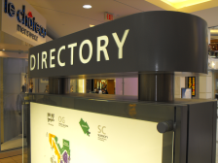


Research Commons “Mall”
Get Information
Consultation
Browse Services
Store manager

Slide 20
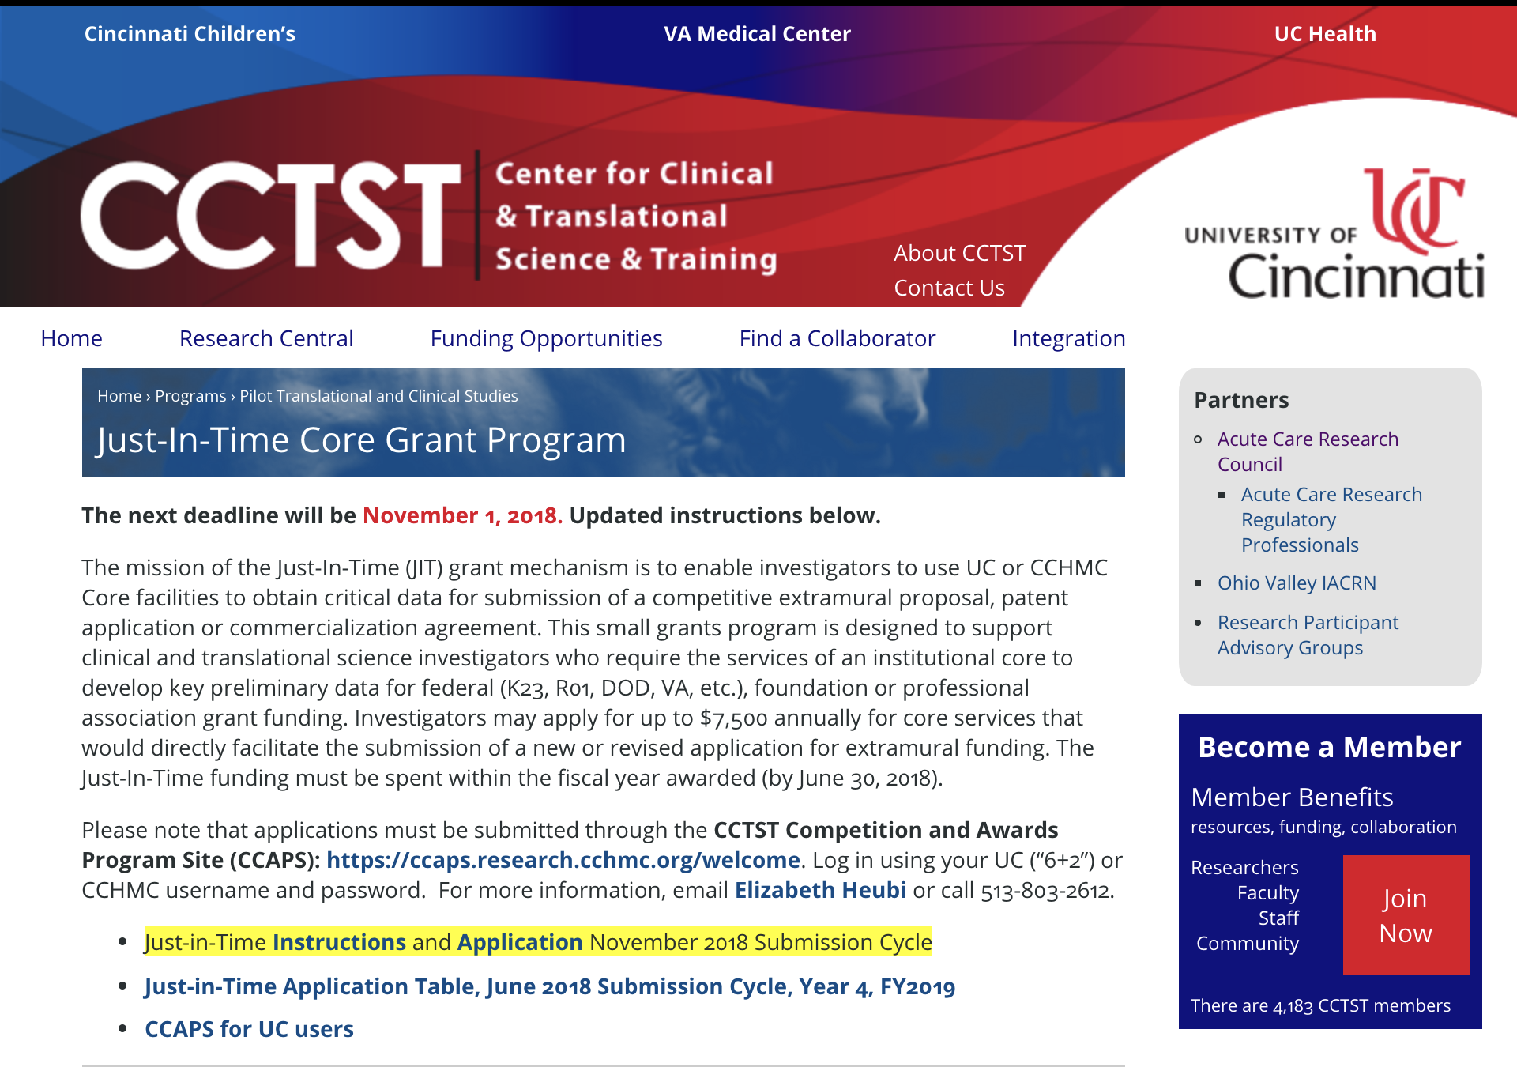

Slide 21
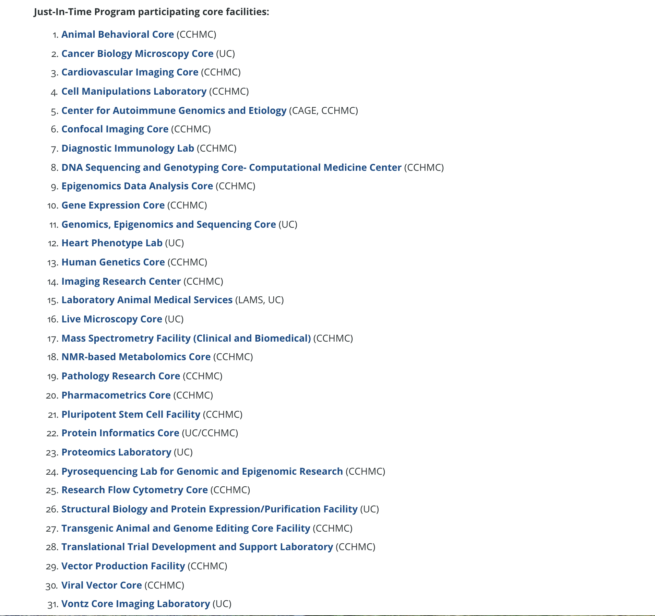

Slide 22
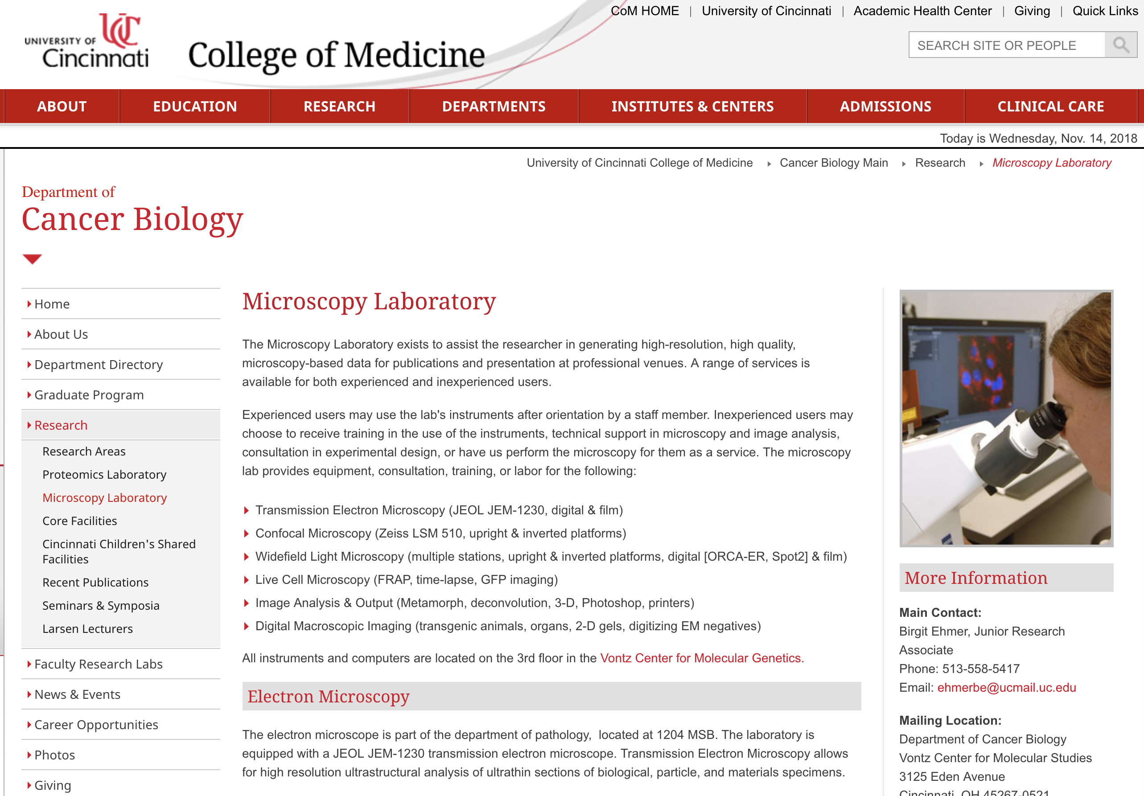

Slide 23
Team Science
Center for Improvement Science evolving
  Home for Team Science
  Developed services for investigators developing research in translational areas related to QI, Health Services Research, Outcomes Research, and CER.
Collaborated with TWD to develop curriculum within MS in CT research and workshops
To date, 3 workshops and 4 consultations
Team Science Course approved for MS/Certificate Programs in CTR

Slide 24
Integration Committee
Established to help researchers formulate strategies to:
  Improve their research
  Overcome environmental challenges
  Build collaborations
360°look at investigator and his/her goals by inter-disciplinary team from across Academic Health Center (including Cincinnati Children’s and VA)
Focus on investigator rather than project
Longitudinal follow-up
https://cctst.uc.edu/integration
Contact Elizabeth Heubi heubiec@ucmail.uc.edu

Slide 25
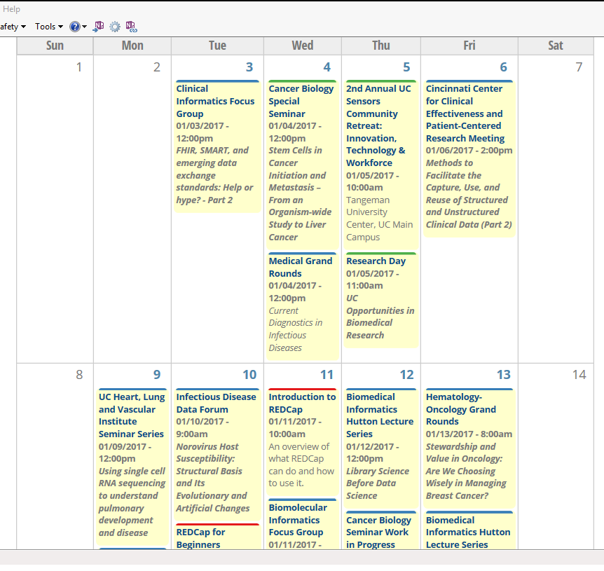
Calendar of Events
https://cctst.uc.edu/events

Slide 26
Universal Research Seminar Calendar
Concept of supporting calendar containing all C/T research across AHC and UC
CCHMC has platform to build on that will allow development
Goal: Enhance more collaboration across disciplines both vertically and horizontally
Expected “go live date”: 1st quarter 2018

Slide 27

Research: Resources and Activities
Information to Assist Department and Unit Heads
Dr. Pat Limbach, Vice President for Research November 5, 2018

Slide 28
Overview
The Office of Research SRS Update
Office of Research Resources & Initiatives Research Policies and Practices Research Challenges

Slide 29
Vision/Mission
Vision: The University of Cincinnati research enterprise integrates the arts, sciences and technology to provide unique opportunities for discovery,
the traditional academic boundaries. UC’s agile research enterprise can address discern future possibilities for exploration that will benefit the greater Cincinnati beyond.
Mission: The Office of Research provides the University of Cincinnati research community with excellent services that enhance scholarship and research.

Slide 30
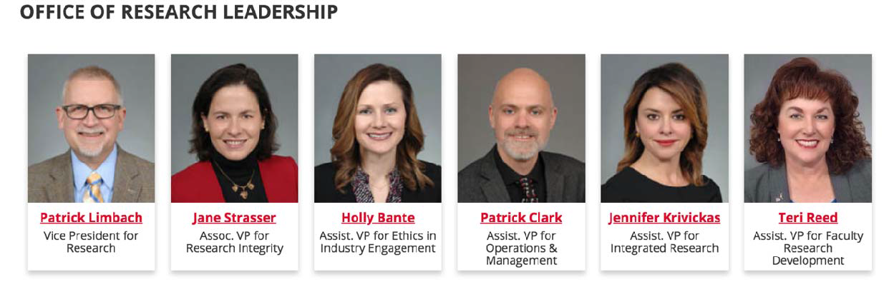
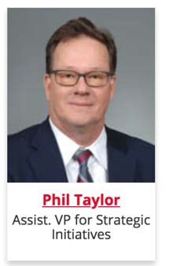
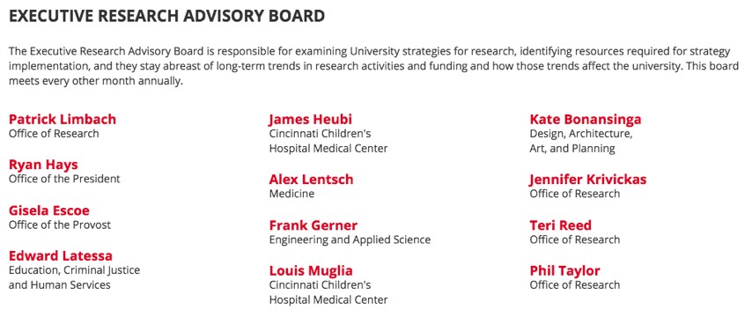
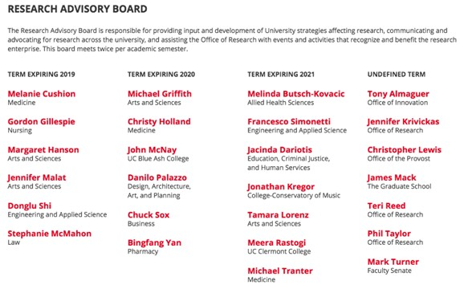
Office of Research – Leadership & Governance

Slide 31
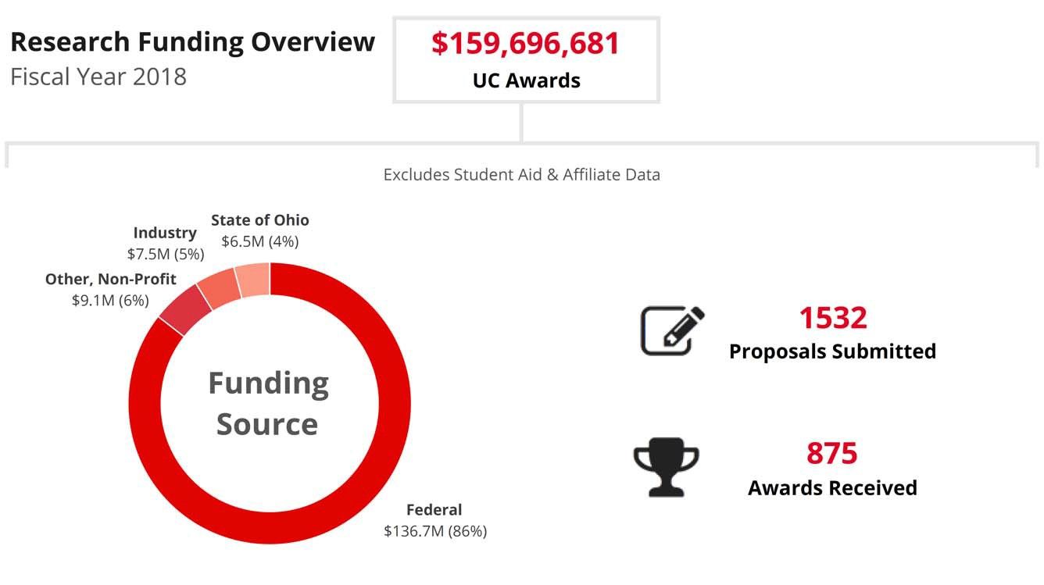
SRS Data: FY 2018

Slide 32
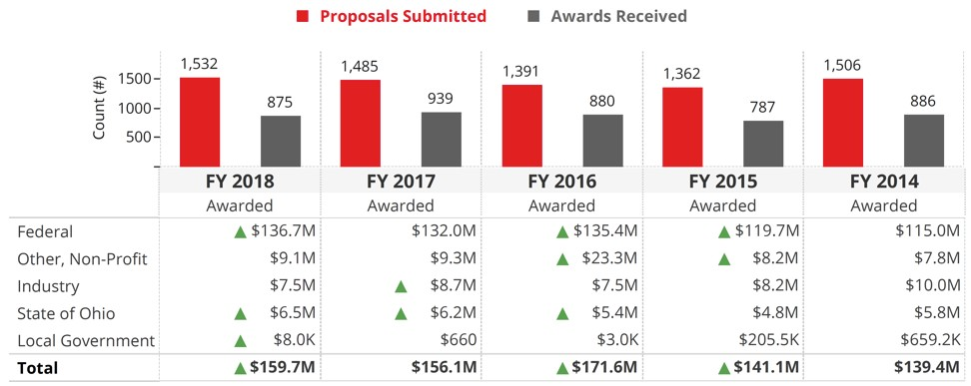
SRS Data: FY 2018

Slide 33




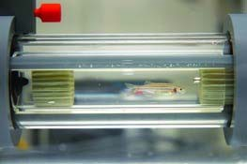
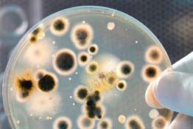
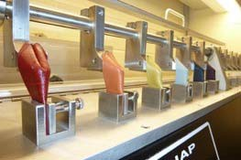

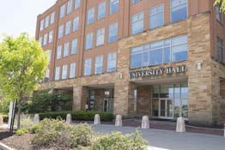
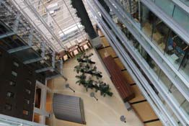
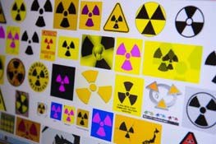
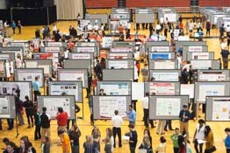
Office of Research – Units
Institutional Animal Care | Biosafety | Ethics in Industry | Export Controls | Government Cost | Human Research
and Use Committee |  | Engagement |  | Compliance | Protection Program
(IACUC)/LAMS |  |  |  |  | (HRPP)
Leather Research | Research Development | Radiation Services | Sponsored Research | Research Integrity | Office of the Vice
Laboratory |  |  | Services |  | President for Research

Slide 34
Office of Research Resources
Office of Research Web Site (research.uc.edu)
Office of Research How2 (researchhow2.uc.edu)
Office of Research Internal Support Dashboard (dataanalytics.uc.edu/t/Research/views/InternalSupportByFiscalYear/Dark)
Research Directory (researchdirectory.uc.edu)
SPIN (research.uc.edu/funding/spin)
SRS Annual Report (research.uc.edu/annual-sponsored-award-report)
SRS Proposals/Awards Live Dashboard (researchhow2.uc.edu/tableau/)
SRS Award Success (>$150K) Dashboard (dataanalytics.uc.edu/t/Research/views/SuccessRate2/Overview)

Slide 35
Office of Research Initiatives
Research Program Development Internal Funding Opportunities Proposal Development Services Signature Programs
Next Lives Here – Urban Futures Pathway inc. Digital Futures Building Skin Science & Technology Collaborative ሺS2TCሻ
CyberResearch Initiative
Advanced Transportation Collaborative
Smart, Secure and Sustainable Communities Interest Group Arts & Humanities in the Age of Impact Interest Group

Slide 36
Office of Research Initiatives
Internal Funding Opportunities
Collaborative Research Advancement Grants Program Track 1: Pilot Teams
Track 2: Strategic Teams
Faculty Bridge Program
Science Engineering ൅ Art Design ሺSE൅ADሻ Advancement Grant
Core Capability Development Grant Program
Core Equipment Grant Program
University Research Council
Creative & Performing Arts Cost Support Program Humanities and Social Sciences Cost Support Program Faculty Research Cost Support Awards Program
Graduate Student Stipend and Research Cost Awards for Faculty-Student Collaboration Undergraduate Student Stipend and Research Cost Awards for Faculty-Student Collaboration

Slide 37
Office of Research Initiatives
Proposal Development Services
Cross-college/Colleges without extensive pre-award infrastructure
Proposal project management and process outlining Proposal editing, formatting, review
Proposal administrative support
Identifying and compiling supplemental information Non-technical writing
Coordination with collaborators and sub-awardee organizations Letters of institutional support/commitment

Slide 38
Office of Research Initiatives
Faculty Research Development New Faculty Orientation
Trans-Disciplinary Research Leadership Program
Annual Research Development and Support Programming Series ሺhttp://research.uc.edu/eventsሻ ሺhttp://research.uc.edu/development/offices/research-development/overviewሻ Research Launch Awards

Slide 39
Office of Research Initiatives
Research Ethics & Integrity
Research Integrity Videos ሺresearch.uc.edu/support/offices/office-of-research-integrity/ሻ
Research & Innovation Week Ethics & Integrity Day ሺApril 4, 2019ሻ CCTST Ethics, Regulatory Support & Knowledge Core
iThenticate
Next Lives Here: Urban Impact – Ethics Center
Anonymous Reporting Hotline ሺwww.uc.edu/about/hotline.htmlሻ

Slide 40
COI Update
COI in the news: NYT, top cancer researcher failed to disclose relevant industry relationships in disclosure forms submitted with manuscripts to several journals, of 180 papersሻ; resigned from MSK
Industry interactions policy revised ሺCOM Council 11/15ሻ clarify relationships Reminders:
Ensure full disclosure about interests and relationships to UC and in other writing, as well as grant applications, where appropriate
Review information posted about you on the CMS Open Payments website Update OAR within 30 days of acquisition or discovery of a new relationship
We are committed to research integrity which includes the obligation to facilitate
which faculty and industry collaborate, and the processes we put in place to review and

Slide 41
Office of Research Initiatives
Communications
Findings – Monthly Office of Research Newsletter ሺresearch.us16.list-manage.com/subscribeሻ
Compliance Matters – Quarterly Office of Research Integrity Newsletter
Impact – Semi-annual Office of Research Report
“Research Calendar” Coming Soon – one stop location for all research talks/events across
Media Placement ሺCincinnati Editionሻ
Research Integrity Videos ሺresearch.uc.edu/support/offices/office-of-research-integrity/ሻ
Research Development Brochures Facts & Figures Wallet Cards

Slide 42
Office of Research Initiatives
Sponsorships, Events & Recognition
WISE GSGA
National Postdoc Association Sigma Xi
Research & Innovation Week ሺApril 1 – 6, 2019ሻ
Topical Events ሺe.g., Water Week with Taft Center; UC Sensors Retreat; Data Analytics Showcaseሻ
Office of the Provost/Office of Research Faculty Awards Office of Research Core Value Awards
Sponsored Research Faculty Recognition Ceremony Research Administrators Appreciation Celebration

Slide 43
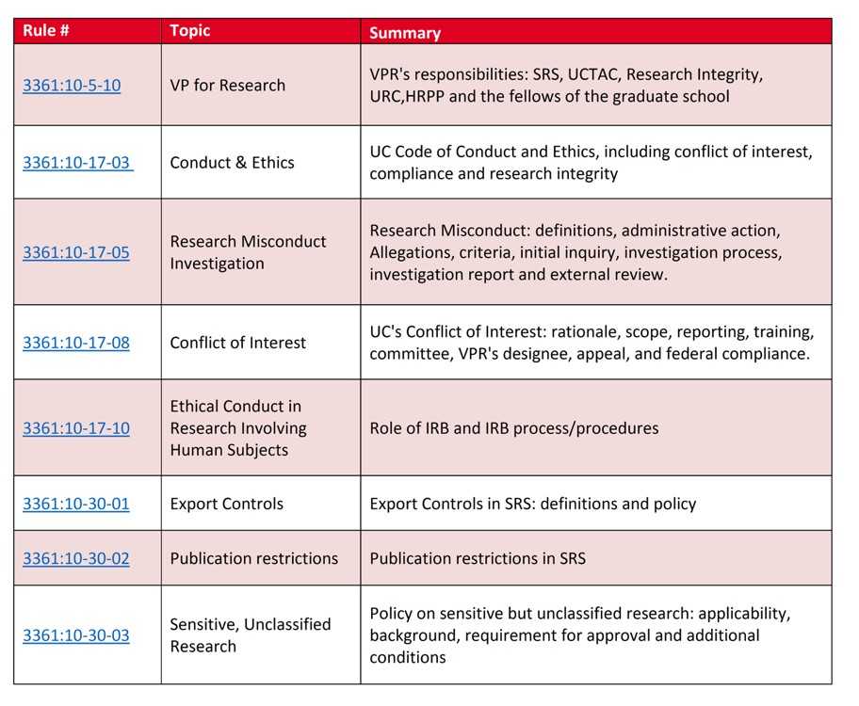
Research Policies & Practices
Board Rules

Slide 44
Research Policies & Practices
University Policies
1.3.2 Conflict of Interest on Externally Funded Projects
2.1.11 Facilities and Administrative Proposal Guidelines, Distribution of Revenue, and Use of Funds 2.1.14 F&A Return for Multiple PIs
2.1.18 Fringe Benefit Rates for Sponsored Projects 2.1.19 F&A Rates for Sponsored Projects
2.1.20 Effort Commitment on Sponsored Projects 2.1.21 Labor Verification on Sponsored Projects
2.1.22 Allowability, Reasonableness and Allocability of Costs for Sponsored Projects 2.1.23 Cost Transfers on Sponsored Projects
2.1.24 Service Centers
2.1.32 Sales & Service Funds

Slide 45
Research Policies & Practices
Office of Research Practices
Startup Support for Hiring
Startup requests come through Dean’s office; Guidelines & Templates available on Research How2; Annual reporting
Support for Faculty Retention
Retention requests come through Dean’s office; Significant unit/college support expected
Cost-Share
PDS handles all requests: Annual budget for mandatory cash cost-share; In some cases, ODHE support also required; where in-kind cost-share required/allowed; Cost-share requests that are not mandatory must be submitted through
Limited Submissions
PDS handles Limited Submissions via web portal ሺrsrch-webserver.uc.edu/ሻ; Two types – faculty research process dependent on type.
ORCID
All faculty should register for an Open Researcher and Contributor ID ሺORCIDሻ through Scholar@UC ሺscholar.uc.edu/ሻ

Slide 46
Additional Resources
A2ru: Alliance for the Arts in Research Universities (www.a2ru.org) workshops and funding
APLU: Council on Research (COR) (www.aplu.org) provides useful research resources
EAB: Education Advisory Board (www.eab.com) Research Forum best practices
Lewis-Burke: Assist with opportunity identification and engagement with congressional delegation
ODHE: OH-TECH (Ohio Supercomputer); Action Fund Cost-Share; Ohio Innovation Exchange (OIEx)
ORAU: Oak Ridge Associated Universities (www.orau.org) funding and networking

Slide 47
Research Challenges
Federal Funding Landscape Research Security & Espionage Export Control
IRB/Human Subjects Research Authorship Guidelines/Policies UC Research Infrastructure
Institutional Conflict of Interest/Conflict of Interest Barriers to Collaborative Research
F&A Rates

Slide 48
Office of Clinical Research

Slide 49
Office of Clinical Research
Director
Justin Osborne
Business Manager
Carla McTaggart
Operations Manager
Maria Stivers
Contracting
Audie Parsons
Dyan Perry
Ashley Kirkpatrick
Compliance
Nate Harris
Billing
Anthony Rogers
Education & Training Program
Emily Werff
Budgets
Kelli Horter
Marketing & Recruitment
Jessie Sikora
Coverage Analyst
Keri Pinger
Greenphire & Administration
Linda Birkley

Slide 50
Key Accomplishments
Five key hires this fiscal year to grow department. Plans for continued growth based on institutional needs
Finalized research coordinator dual comp model to resolve employer/employee concerns and compliance risks. Rollout of new model is planned for Jan 1 2019
Created new career ladder for Office of Clinical Research staff with goal of retaining our talent to build institutional knowledge and improve services

Slide 51
Key Accomplishments Cont.
Assisted UCCI to increase accrual rates and ease administrative burden.
Implementing eReg (electronic regulatory system) for Cancer Institute and rolling out to rest of institution
  Research functions in Epic, research billing
  Clinical Trials Management System
Improvements to Contracting process – turnaround has improved and continues to improve
Next:
  Feasibility?
  Additional accrual strategies?

Slide 52
Completed action items to contribute to increase:
Set overall accrual target
Set disease specific accrual goals
Dashboard for monthly reporting to physicians and staff
Community affiliate communication on trial availability
Chief Resident support for candidate pre-screening
Filled new and replacement positions

Slide 53

Questions?
https://cctst.uc.edu

