Slide 1
Identifying and Managing Burnout
UC-COM Faculty Development Lecture Series
Jennifer Rose V. Molano, MD
UC Department of Neurology and Rehabilitation Medicine
8 November 2017

Slide 2
Learning Objectives
1. To define the components and consequences of burnout. 2. To explain the drivers for burnout and wellbeing 3. To summarize potential strategies to promote wellbeing and resilience

Slide 3
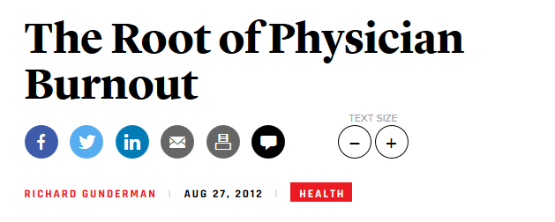
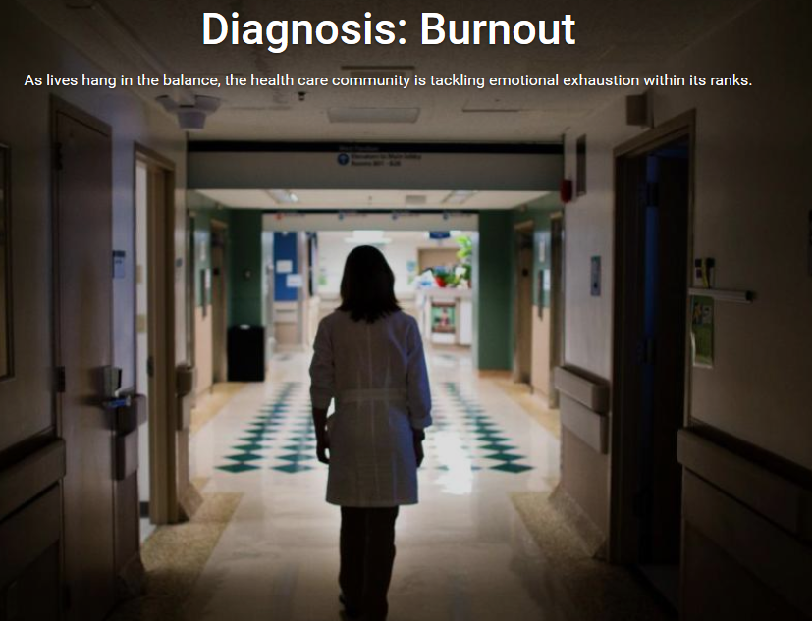
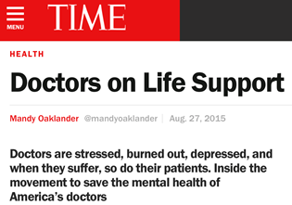
New York Times
The Atlantic
US News and World Reports

Slide 4
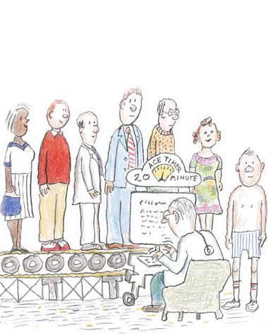
Pharos, Spring 2016 Issue

Slide 5
What Is Burnout?
Three domains:
Depersonalization
“ I feel I look at certain patients/clients impersonally, as if they are objects.”
Emotional exhaustion
“I feel emotionally drained by my work.”
A sense of low personal accomplishment
Questions from the Maslach Burnout Inventory

Slide 6
Am I Burned Out?
Maslach Burnout Inventory is one of the most commonly used assessments
22 items on a 7-point Likert scale
Emotional exhaustion
Score < 17: Low
18-29: Moderate
> 30: High
Depersonalization
Score < 5: Low
6-11: Moderate
> 12: High
Personal accomplishment
Score < 33: High burnout
34-39: Moderate burnout
> 40: Low burnout
http://www.mindgarden.com/117-maslach-burnout-inventory

Slide 7
Shorter Surveys
Just a few questions can be very useful
“I feel burned out from my work”
“I have become more callous toward people since I took this job”
Ask about work-life balance
Control over schedule
Hours worked
Courtesy: Dr. Neil Busis

Slide 8
Shorter Surveys

Slide 9
Prevalence of Burnout in Training
Medical Students: 49%
Mean emotional exhaustion score: 23.8
Mean depersonalization score: 9.3
Residents: 60%
Prevalence of high emotional exhaustion: 44-50%
Increased prevalence of high depersonalization
Dyrbye L, Med Educ 2016;50(1)

Slide 10
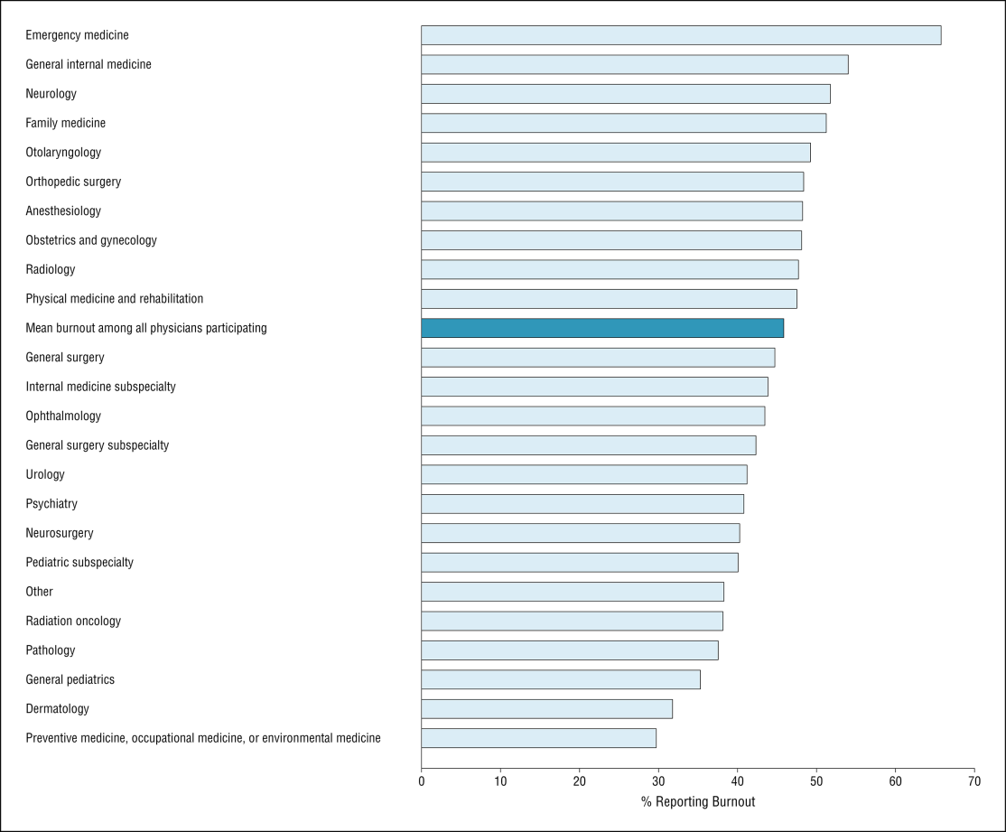
From: Burnout and Satisfaction With Work-Life Balance Among US Physicians Relative to the General US Population
Arch Intern Med. 2012;172(18):1377-1385. doi:10.1001/archinternmed.2012.3199
All Practicing Physicians:
45.8%
Burnout by specialty.
Copyright © 2015 American Medical Association. All rights reserved.

Slide 11
Burnout by specialty:
2011 and 2014 Data
Shanafelt, Mayo Clinic Proceedings; 2015

Slide 12
Drivers of Burnout: Individual Factors The Physician/Health Care Provider Personality
Adaptive
Maladaptive
Conscientiousness
Commitment to patients
Staying current
Cognizant of patient’s trust
Difficulty relaxing
Work-life imbalance
Sense of responsibility beyond one’s control
Feeling inadequate
Difficulty with boundaries and limit-setting
Difficulty taking leisure time
Conflict between selfishness versus healthy self-interest
Gabbard, JAMA 1985;254:2926-2929
West: 1/2017 IAMSE Webinar

Slide 13
Drivers of Burnout Workplace Factors
Workplace factors associated with higher emotional exhaustion:
High demands
Low job control
High work load
Low Reward
Job insecurity
Aaronson G, et al. BMC Public Health, 2017

Slide 14
Shanafelt, Mayo Clinic Proceedings 2016
Maslach, World Psychiatry 2016

Slide 15
Consequences of Burnout
Shanafelt, Mayo Clinic Proceedings 2016

Slide 16
From Burnout to Wellbeing Do Mitigation Strategies Work?
Meta-analysis of 52 RCT and cohort studies
Individual and organizational strategies:
Decreased burnout from 54 to 44%
Decreased emotional exhaustion scores from 23.8 to 21.2 points
Decreased depersonalization scores from 9.1 to 8.41 points.
Both individual and organizational strategies reduced burnout
More research needed on combined methods
West, Lancet 2016

Slide 17
From Burnout to Wellbeing Mitigation Strategies: Individual
Stress-management/self-care techniques
Mindfulness-based stress reduction
Facilitated small group discussions
Finding Meaning in Medicine
Balint groups
Mind-Body groups
Communication skills training
West, Lancet 2016 Pipas: 2017 IACME Webinar

Slide 18
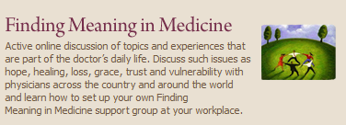
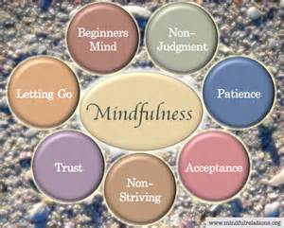

Slide 19
From Burnout to Wellbeing Mitigation Strategies: Work Unit/Organizational
Physician Engagement Groups
Biweekly facilitated physician discussion groups with mindfulness, reflection, shared experience, and small group learning for 9 months
One hour of paid time every other week provided by the institution
Improved multiple areas associated with burnout
West JAMA Intern Med 2014;174(4)

Slide 20
From Burnout to Wellbeing Mitigation Strategies: National

Slide 21
Towards a Mindset of Wellbeing Six Areas of Work Engagement
Workload
Control
Reward
Community
Fairness
Values
Maslach and Leiter. Med Teach, 2017

Slide 22
Towards a Mindset of Wellbeing The Stanford Model of Professional Fulfillment

Slide 23
Towards a Mindset of Wellbeing Personal Resilience
riversearch.com
newstartproject.org

Slide 24
Towards a Mindset of Wellbeing Components of Resilience
Make connections
Reframe how you interpret and respond to events
Accept that change is a part of living
Move towards your goals
Take decisive actions
Look for opportunities of self-discovery
Nurture a positive view of yourself
Keep perspective
Maintain a hopeful outlook
Take care of yourself
APA Road to Resilience
http://www.apa.org/helpcenter/road-resilience.aspx

Slide 25
Towards a Mindset of Wellbeing Personal Resilience
Self-care
Sleep, physical activity
Managing energy
Physical, emotional, mental, spiritual
Emotional intelligence
Self-awareness, self-regulation, motivation, empathy, social skills
Mindfulness
Meditation, journaling, conversation
APA Road to Resilience
http://www.apa.org/helpcenter/road-resilience.aspx
Dewey C. Vanderbilt Center for Professional Health
http://ww2.mc.vanderbilt.edu/cph

Slide 26
Towards a Mindset of Wellbeing Personal Resilience
Self-Awareness and Knowledge
Self-assessment
Self-Care and Authenticity
Personal mission and vision statement
Resilience
Optimism, social support, exercise, flexibility
Self-Improvement
Pipas: 1/2017 IAMSE Webinar

Slide 27
Towards a Mindset of Wellbeing B-A SMARTER Goals and Objectives
Goal: To improve overall wellbeing
Barriers
Accountability
Specific
Measurable
Appropriate
Relevant
Timely
Evaluate
Re-evaluate
Dewey C. Vanderbilt Center for Professional Health
http://ww2.mc.vanderbilt.edu/cph

Slide 28
Towards a Mindset of Wellbeing: The Stanford Model of Professional Fulfillment

Slide 29
Towards a Mindset of Wellbeing: Personal Resilience and A Culture of Wellness
Back et al. J Pain and Symptom Management, 2016

Slide 30
Towards a Mindset of Wellbeing: Local Efforts
Cincyimages.com

Slide 31
Towards a Mindset of Wellbeing:
Culture Transformation Training
Courtesy: Dr. Anya Sanchez

Slide 32
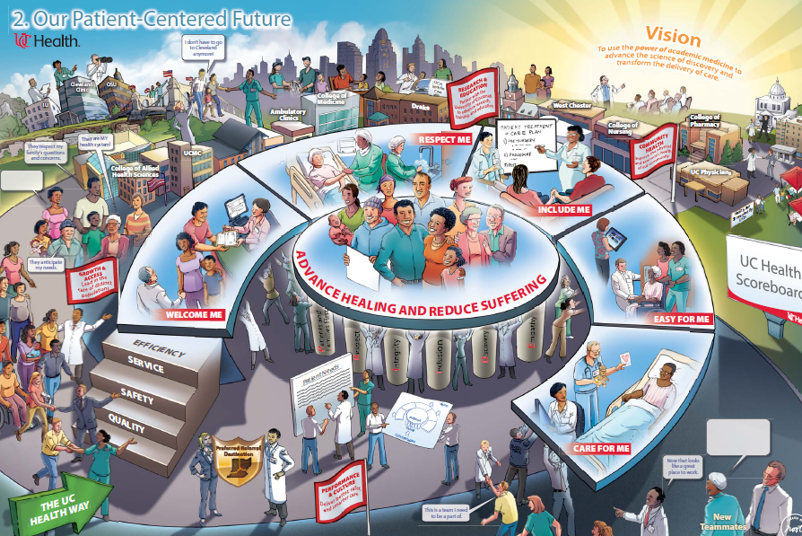
Towards a Mindset of Wellbeing:
Culture Transformation Training
Courtesy: Dr. Anya Sanchez

Slide 33
Towards a Mindset of Wellbeing: UC-College of Medicine
Mind-Body Groups (Sian Cotton, PhD)
Intensive 11-week experience for students
Mind-body skills
Mindfulness
Guided imagery
Deep breathing exercises
Narrative/Reflective exercises
Initiated at UC-COM, now offered across other colleges at UC

Slide 34
Towards a Mindset of Wellbeing: UC-College of Medicine

Slide 35
Towards a Mindset of Wellbeing: UC-College of Medicine
Faculty Development Seminars

Slide 36
Towards a Mindset of Wellbeing: Positive Psychology and A Culture of Wellness
The study of the strengths and virtues that enable individuals, communities and organizations to thrive.
Eckleberry-Hung J, Acad Med; 2017
Notes:
Father of positive psychology is Martin Seligman but this is a relatively new field in psychology virtually unstudied until to late 1990’s. We are going to talk about positive psychology from the perspective of the work that has been done by Shawn Achor starting at Harvard but applying his work much more broadly throughout the world. So we would like to start with sharing with you a presentation by Shawn Achor

Slide 37
Towards a Mindset of Wellbeing: Positive Psychology and A Culture of Wellness
The Seven Principles
Social Investment
The 20 Second Rule
Activation energy
The Zorro Circle
Locus of control
Falling Up
The Tetris Effect
Happiness, Gratitude, Optimism
The Fulcrum and the Lever
The Happiness Advantage
Success
Happiness
Achor: The Happiness Advantage

Slide 38
Principle #1: The Happiness Advantage
Happiness Success
Success Happiness
Physicians primed to feel happy were much faster and more creative in coming up with the correct diagnosis with less anchoring
Achor: The Happiness Advantage
Notes:
The first principle relates to the realization that we need to make a fundamental shift in our perception that if we are successful, we will be happy. Extensive research has now shown that happiness and a positive mindset results in increased intelligence, creativity, motivation and success.
An experiment with a group of seasoned clinicians where 1/3 were primed to be happy, 1/3 were given some neutral medical information and 1/3 received nothing. The happy primed docs were twice as fast at coming up with the correct diagnosis but also had less “anchoring” or inflexibility of thinking. How were they primed to be happy? They were given a lollipop (which they could not even eat!)
So the implications for our work environment is significant. If we have more autonomy, flexibility, better support and more focus on employee satisfaction, just think how much happier we would be but also, how improved our care would be.

Slide 39
Principle #2: The Fulcrum and The Lever
In order to maximize our potential, we can adjust:
The length of our lever, i.e., the potential power and possibility we believe we have
OR
The position of the fulcrum, i.e., the mindset with which we generate the power to change
Example would be to reframe your perspective about your employment:
Job
Career
Calling
Achor: The Happiness Advantage
Notes:
Example of this is Amy the Unicorn by adjusting her mindset she moved beyond her pain and became something she dreamed of being.

Slide 40
Principle #3: The Tetris Effect
This principle teaches us to retrain our brain to spot pattern of possibility and seize opportunities
Drivers of the Positive Tetris Effect:
Happiness
Gratitude
Optimism
Example: List 3 positive things that happened in the last 24 hours
Achor: The Happiness Advantage

Slide 41
Principle #4: Falling Up
Finding the mental path that leads us up out of failure or suffering and teaches us to be happier and more successful because of it
Example: Changing from a volume based to value based reimbursement system may threaten financial viability of a practice
OR
This opportunity may help to develop a better model of care utilizing all the skills in a practice and improving patient access and experience
Achor: The Happiness Advantage

Slide 42
Principle #5: The Zorro Circle
Self-awareness
Locus of control
Focus on one small goal
Achor: The Happiness Advantage

Slide 43
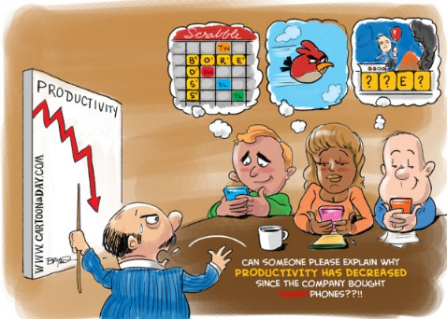
Principle #6: The 20 Second Rule
The 20 Second Rule
Lower the activation energy (or the effort to overcome inertia) for the habits you want to adopt
Corollary: Make the distracting activities more difficult
E.g., Remove shortcuts
We like to follow the path of least resistance
Achor: The Happiness Advantage

Slide 44
Principle #7: Social Investment
Interactions with others are crucial.
Actively and constructively respond to good news.
Be present.
Achor: The Happiness Advantage

Slide 45
Towards a Mindset of Wellbeing B-A SMARTER Goals and Objectives
Goal: To promote positivity for my personal health and wellness
Barriers Time, energy level
Accountability I will let my family know about my goal
Specific Write down three good things for 14 consecutive days
Measurable Journal entries
Appropriate Will promote personal resilience
Relevant Important as a personal strategy to prevent burnout
Timely Yes – Short term measure within two weeks
Evaluate Assess - Will assess progress and outlook after two weeks
Re-evaluate Re-evaluate after a month
Dewey C. Vanderbilt Center for Professional Health
http://ww2.mc.vanderbilt.edu/cph

Slide 46
Towards a Mindset of Wellbeing: Personal Resilience and A Culture of Wellness
Back et al. J Pain and Symptom Management, 2016
Maslach and Leiter. Med Teach, 2017

Slide 47
From Burnout to Wellbeing: The Stanford Model of Professional Fulfillment

Slide 48
Towards a Mindset of Wellbeing: Challenges
Courtesy: Dr. David Ficker

Slide 49
Towards a Mindset of Wellbeing: Challenges
Miyasaki J, et al. Neurology; 2017

Slide 50
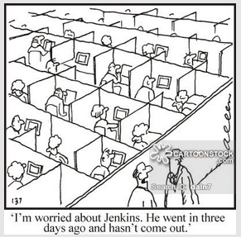
Towards a Mindset of Wellbeing: Challenges

Slide 51
Towards a Mindset of Wellbeing Efficiency of Practice: Challenges
Ogrinc BMJ Quality and Safety 2014; 23:265-267

Slide 52
Towards a Mindset of Wellbeing: A Organizational Approach
Acknowledge and assess the problem
Harness the power of leadership
Develop and implement targeted interventions
Cultivate community at work
Use rewards and incentives wisely
Align values and strengthen culture
Promote flexibility and work-life integration
Provide resources to promote resilience and self-care
Facilitate and fund organizational science/Invest in the effort
Shanafelt, Mayo Clinic Proceedings 2016

Slide 53
Towards a Mindset of Wellbeing: An Organizational Approach
https://www.stepsforward.org/modules/joy-in-medicine

Slide 54
Towards a Mindset of Wellbeing: Opportunities
Continuing to work towards optimizing workload and autonomy.
Understanding and addressing burnout and career satisfaction in residents, nurses, mid-level practitioners, other associates/support staff, and research scientists
Continue to support efforts to promote well-being and resiliency:
Self-Awareness, Self-Care, and Self-Improvement
Promote and encourage a culture of wellness, practice efficiency, and personal resilience.

Slide 55
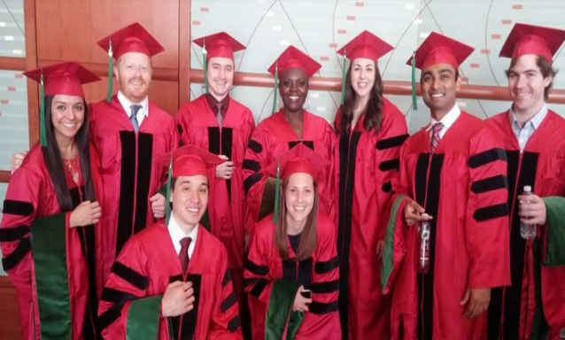
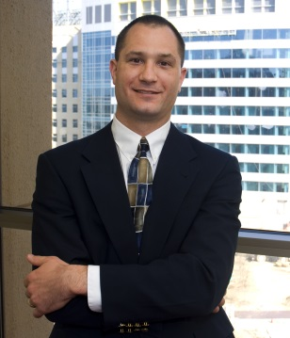
Thank you
PLUS:
All of my patients
All of the clinic support staff and managers
All of the sleep lab techs
All of the nurses, CNPs, PAs, residents and fellows
Administrative assistants:
Angela Schoner
Lori Selm
Misty Wethington
Maggie Baker
And many, many more …

